Slide 4
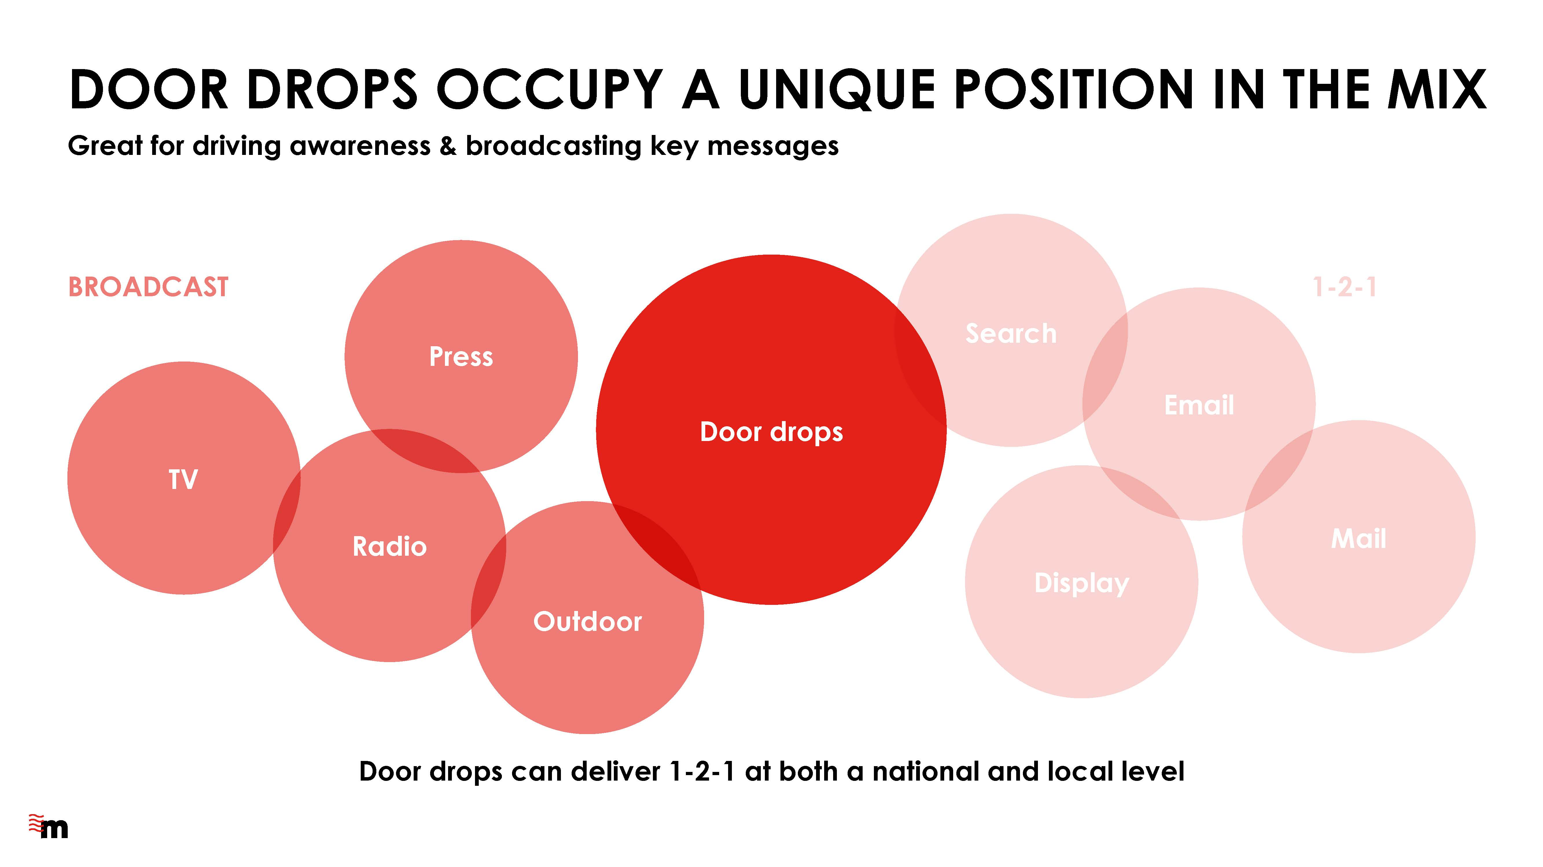

Slide 7
THANK YOU
www.marketreach.co.uk

