Slide 1
MAIL IS TRUSTED
Mail offers a highly trusted, privacy-first option for brands, and consumer trust in the medium is growing

Slide 2
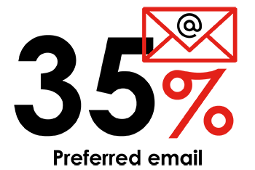
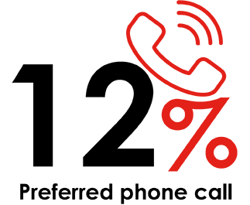
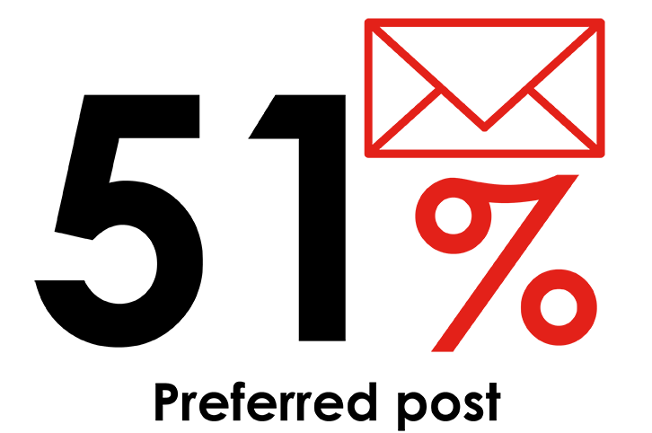
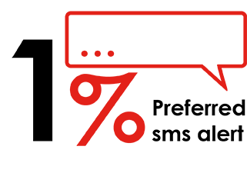
Mail is valued because it is secure
Question : Thinking about how companies or organisations contact you, what is your preferred method of contact for sensitive or confidential account information?

Slide 3
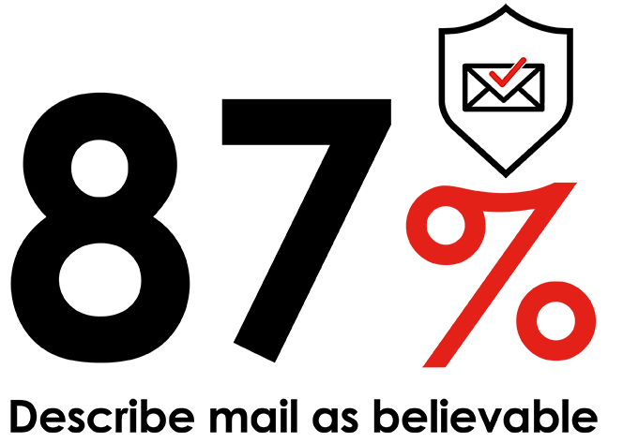
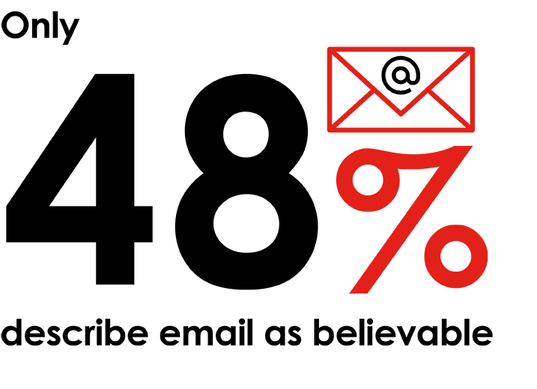
Mail builds credibility
Question : Now thinking about the mail and email you receive from companies, how would you describe the way they communicate with you?

Slide 4
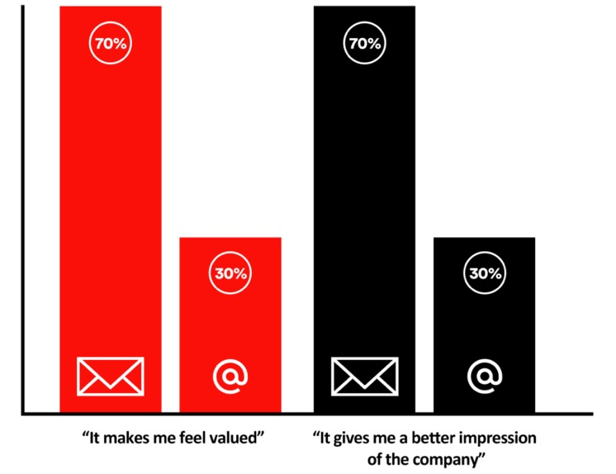
How mail builds trust
Question : Do the following statements relate mostly to mail or email you receive from companies?
Sources: Royal Mail Marketreach Research Conducted by Kantar TNS in May 2017: Base 1269 UK adults, nationally representative sample

Slide 5
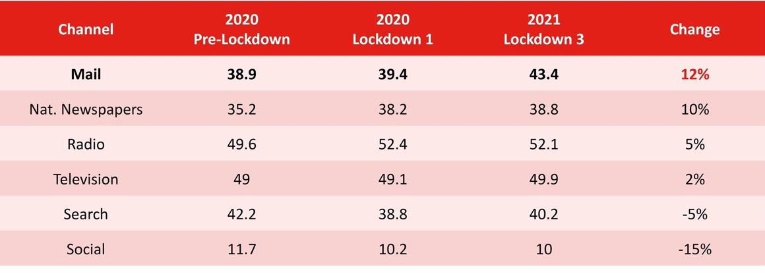
Trust in mail has continued to grow
Question : Please indicate how much you trust what you see/hear or read on each of the following?
Sources: IPA TouchPoints 2021 – Lockdown Data (Jan-Mar 21) Base: All Adults

Slide 6
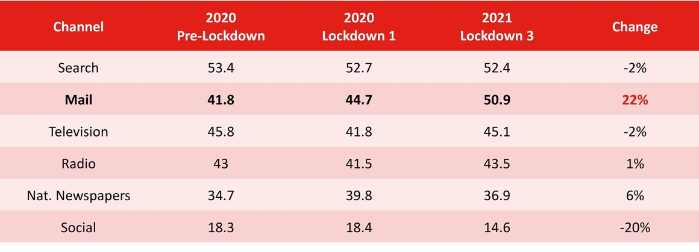
Mail is 2nd most trusted channel for gen z
Question : Please indicate how much you trust what you see/hear or read on each of the following?
Sources: IPA TouchPoints 2021 – Lockdown Data (Jan-Mar 21) Base: 15-24 year-olds

Slide 7
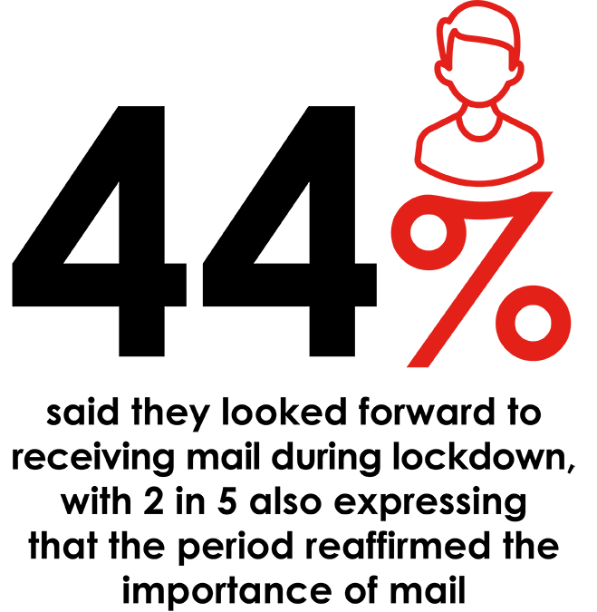
Mail delivers positivity and trust
Direct mail is far more likely to drive conversations and web traffic vs a year ago

Slide 8
THANK YOU
www.marketreach.co.uk

