Slide 1


MAIL MEASUREMENT AND ATTRIBUTION IS EASIER THAN YOU THINK

Slide 2

Connected mail delivers richer insight, real-time analytics
& direct attribution
Draw conclusions & correlations from a wider range of behavioural, demographic, geo-location, engagement and dwell-time metrics
Easy to report response, conversion and ROI
Keep the C-suite informed on campaign performance at every stage, rather than just reporting the longtail effect
Direct attribution through a digital CTA; QR codes or unique online codes can measure the true impact of the mail in a multi-channel campaign

Slide 3
Think about attribution methods
Two methods of measuring campaigns – using both is optimal
DIRECT RESPONSE – Pros and Cons
OBSERVATION – Pros and Cons
Physical or digital response mechanism
Name and address match backs, QR codes, coupon codes, redemptions in-store or against existing accounts, loyalty cards, online/telephone or using existing customers account e.g. telephone number
Ideal as responders can be identified for follow up and further analysis
Some attribution may be lot as responders purchase without use of measurements mechanics
Uplift measured in footfall differential between exposed and holdout stores
Or sales of specifically promoted items
Ideal as there is no need to capture response data and shows a full sales picture
Method requires significant mailing volumes in order to obtain statistical significance (especially in high footfall stores)
Can also be disrupted by unusual sales activity
Requires careful consideration when splitting exposes and holdout store groups

Slide 4
Using control and fallow groups
To understand the true uplift of campaign activity
CONTROL GROUP
FALLOW (AKA “HOLD-OUT”) GROUP
A sample of communication held back to assess the uplift vs. no activity.
Shows short-term uplift and ROI for campaign. Essential for proving short term payback, but somethings misleading as does not include long-term impact.
A sample of customers omitted from an entire programme of communications or marketing activity.
Shows the long-term effect all marketing activity over a period of months or even years. Very powerful for showing ong-term impact, but requires commitment to keep the group out of marketing for a sufficiently long period.

Slide 5
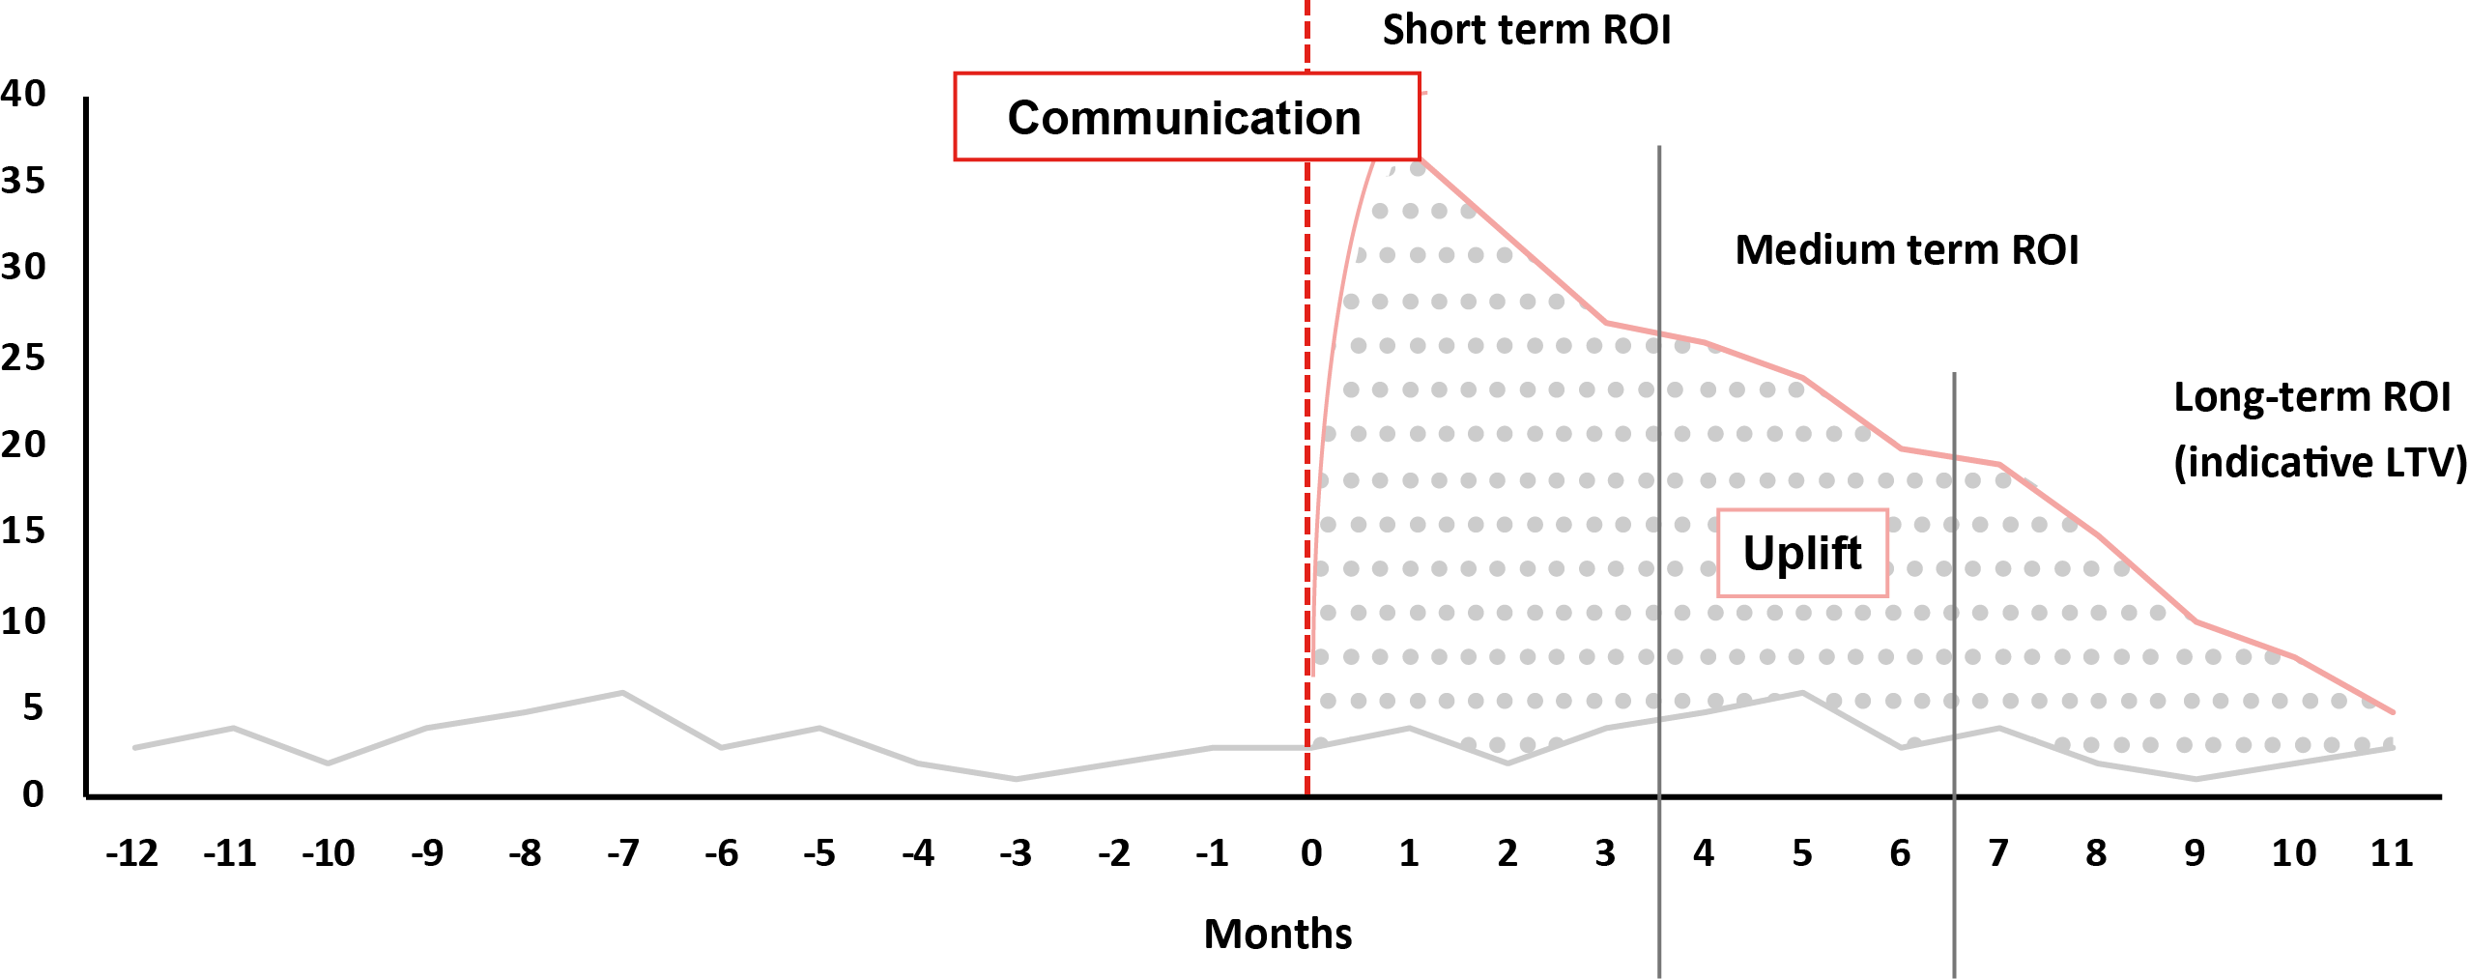
Access over multiple time periods
To understand the true uplift of campaign activity
Short term ROI
Communication
Medium term ROI
Long term ROI
(indicative LTV)
Uplift

Slide 6
THANK YOU
www.marketreach.co.uk

