Slide 1
MAIL MEDIA IS MORE EFFECTIVE THAN EVER
Providing unrivalled cut though, engagement and longevity

Slide 2
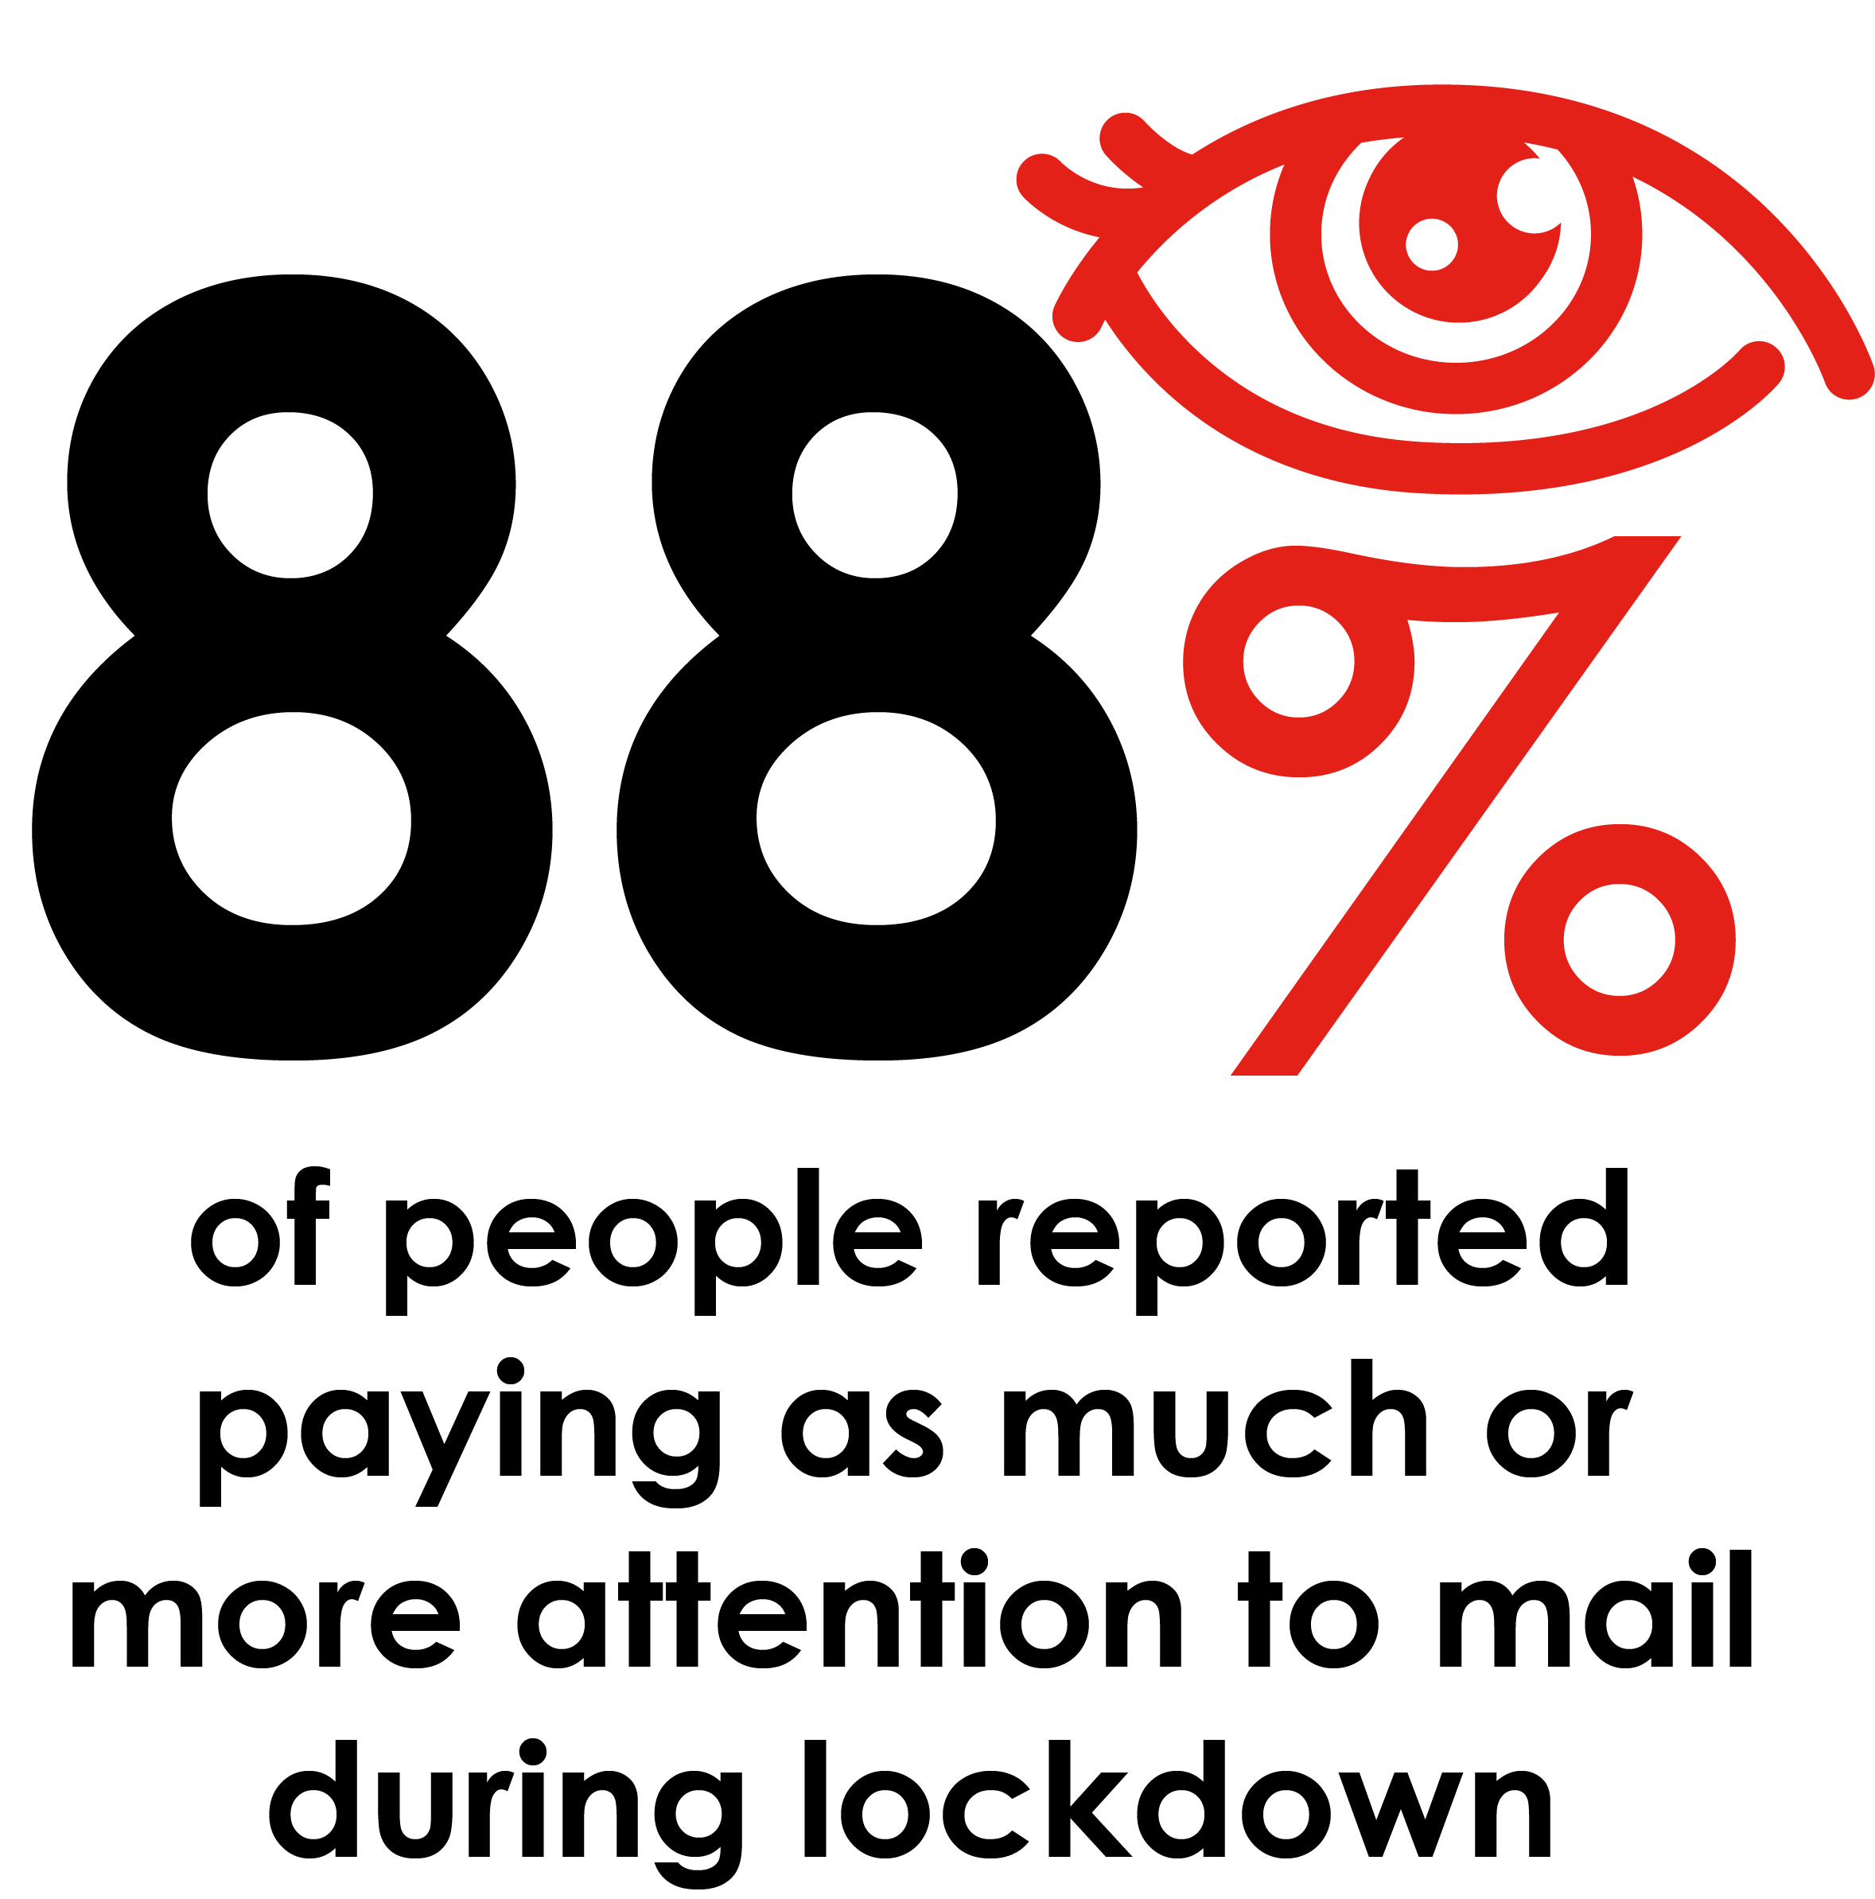
Mail cuts through
Sources: Royal Mail Marketreach, Coronavirus Research, Trinity McQueen 2020

Slide 3
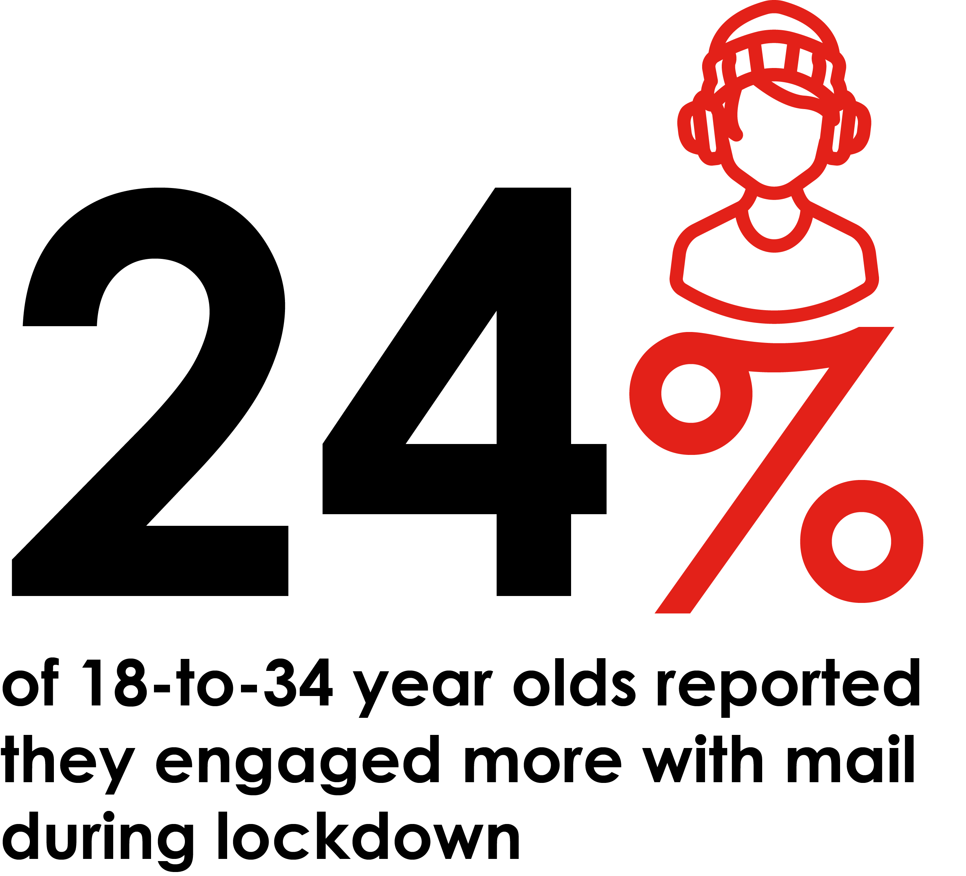

Slide 4
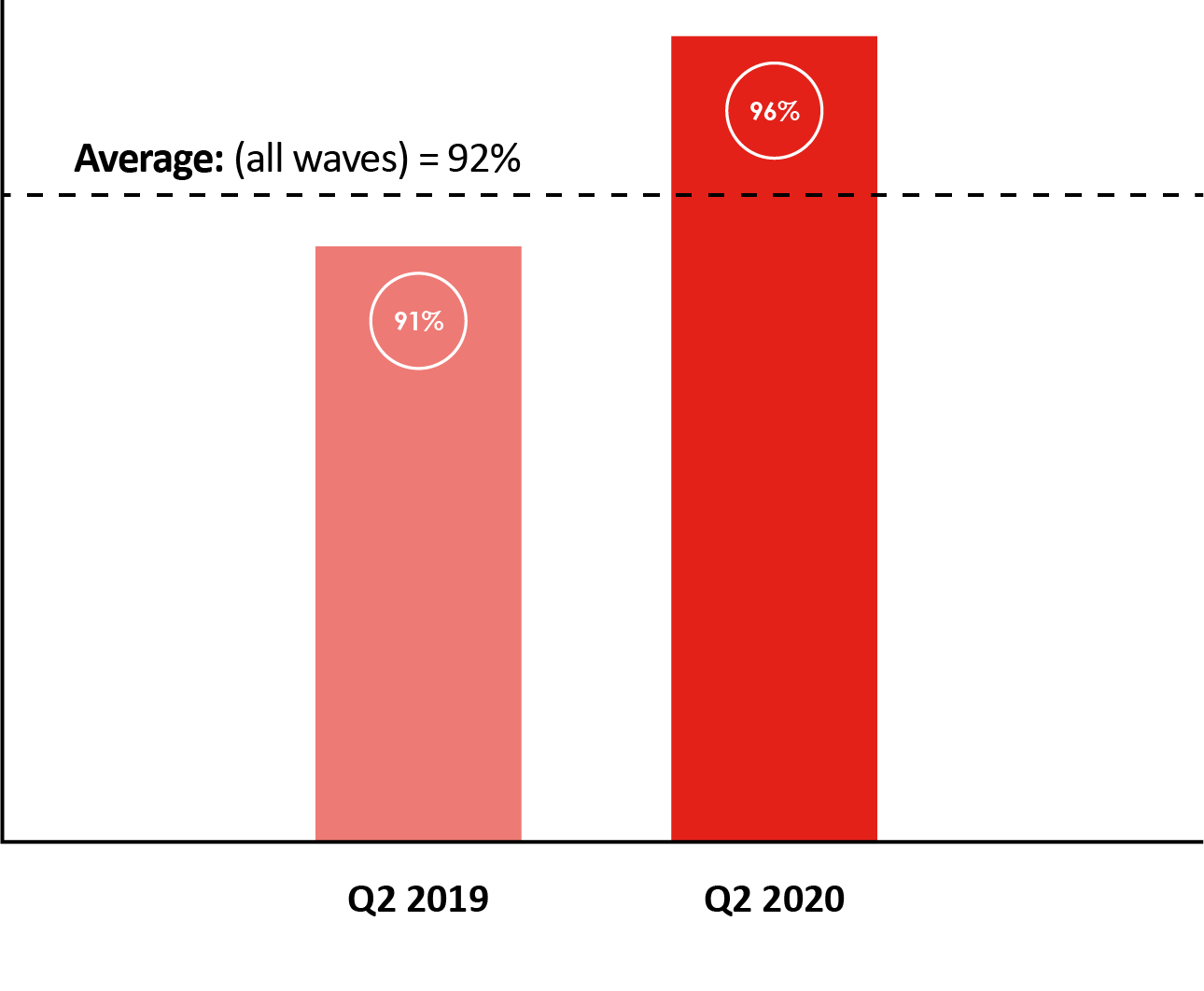

Slide 5
Consistently high engagement rates
Across all mail media types – between 76% - 99%
ENGAGED: % of mail processed in some way including – opening, reading, sorting, put aside for later, filed, put on display, put in the usual place.
MINIMALLY PROCESSED: % of mail thrown way only.

Slide 6
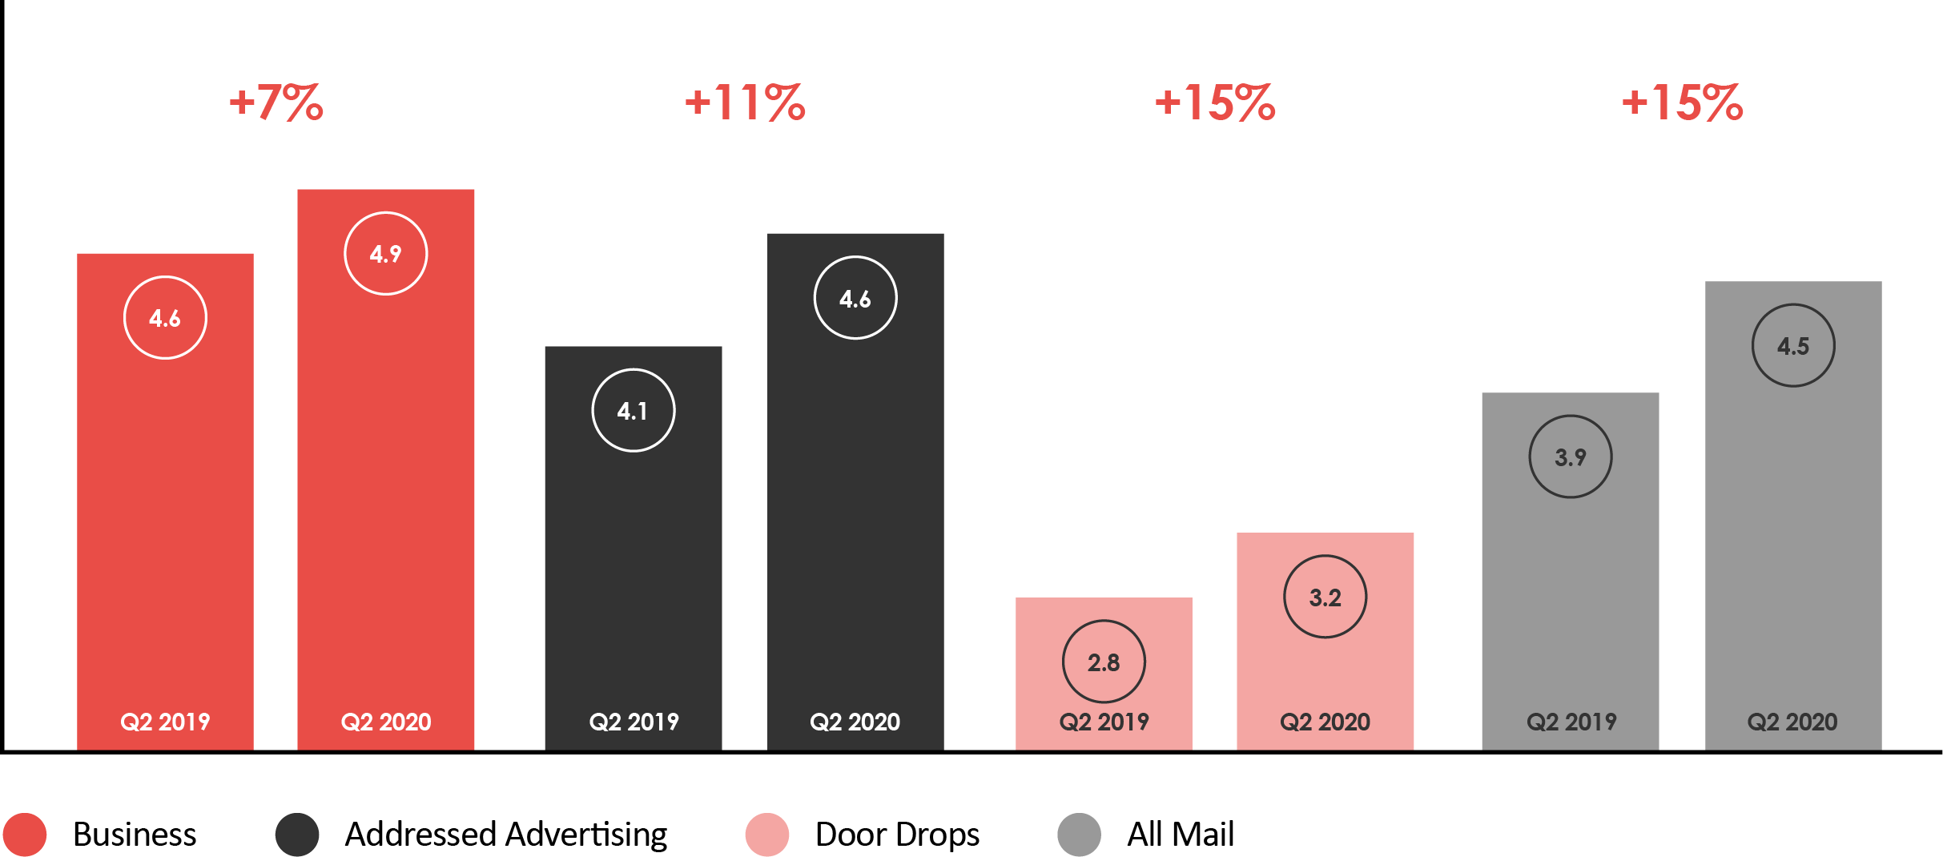
Huge growth in yoy interaction with all mail types, particularly ad mail & door drops

Slide 7
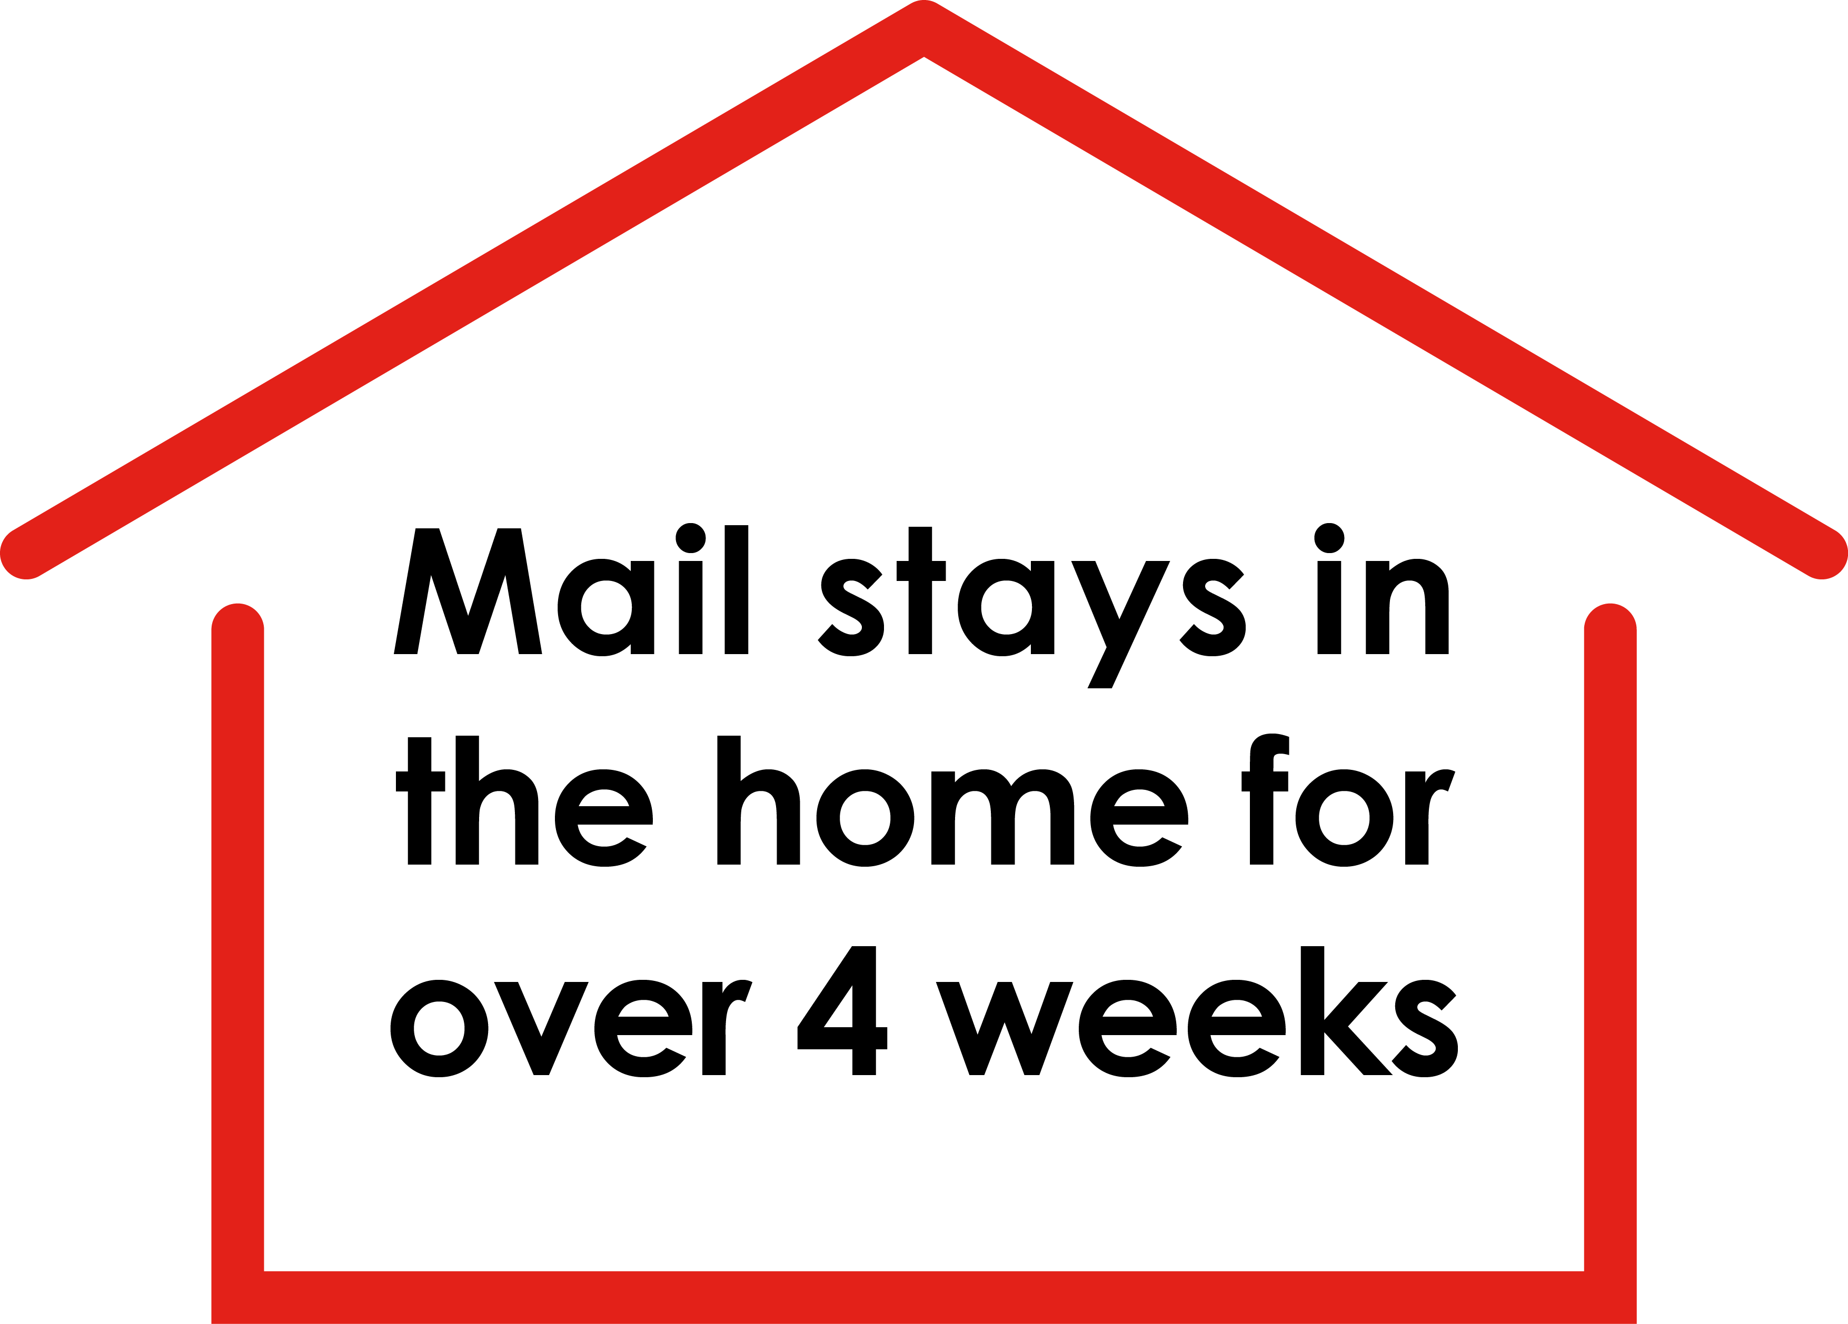

Slide 8
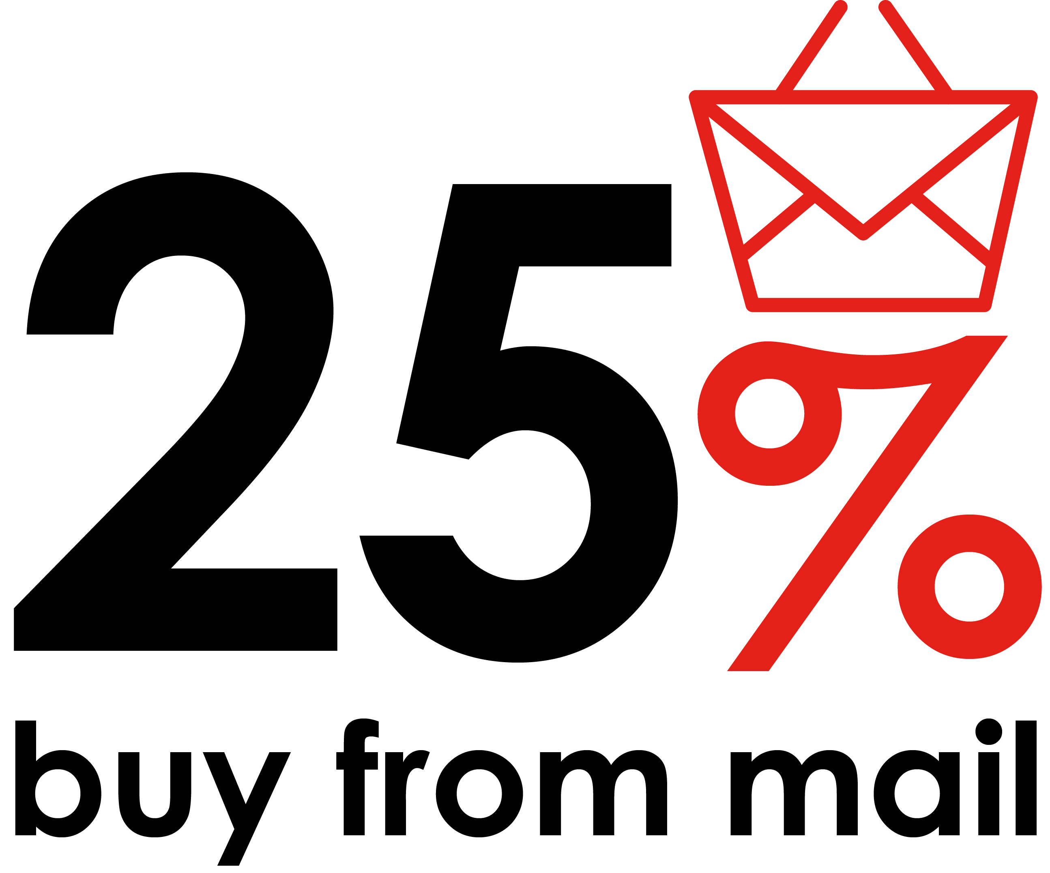
Convert prospects to buyers
Adding mail to the mix boosts the bottom line for businesses. According to the IPA, 25% of people have bought from a brand as a result of receiving mail.

Slide 9
THANK YOU
www.marketreach.co.uk

