Slide 1
MAIL DELIVERS STRONG COMMERCIAL OUTCOMES

Slide 2
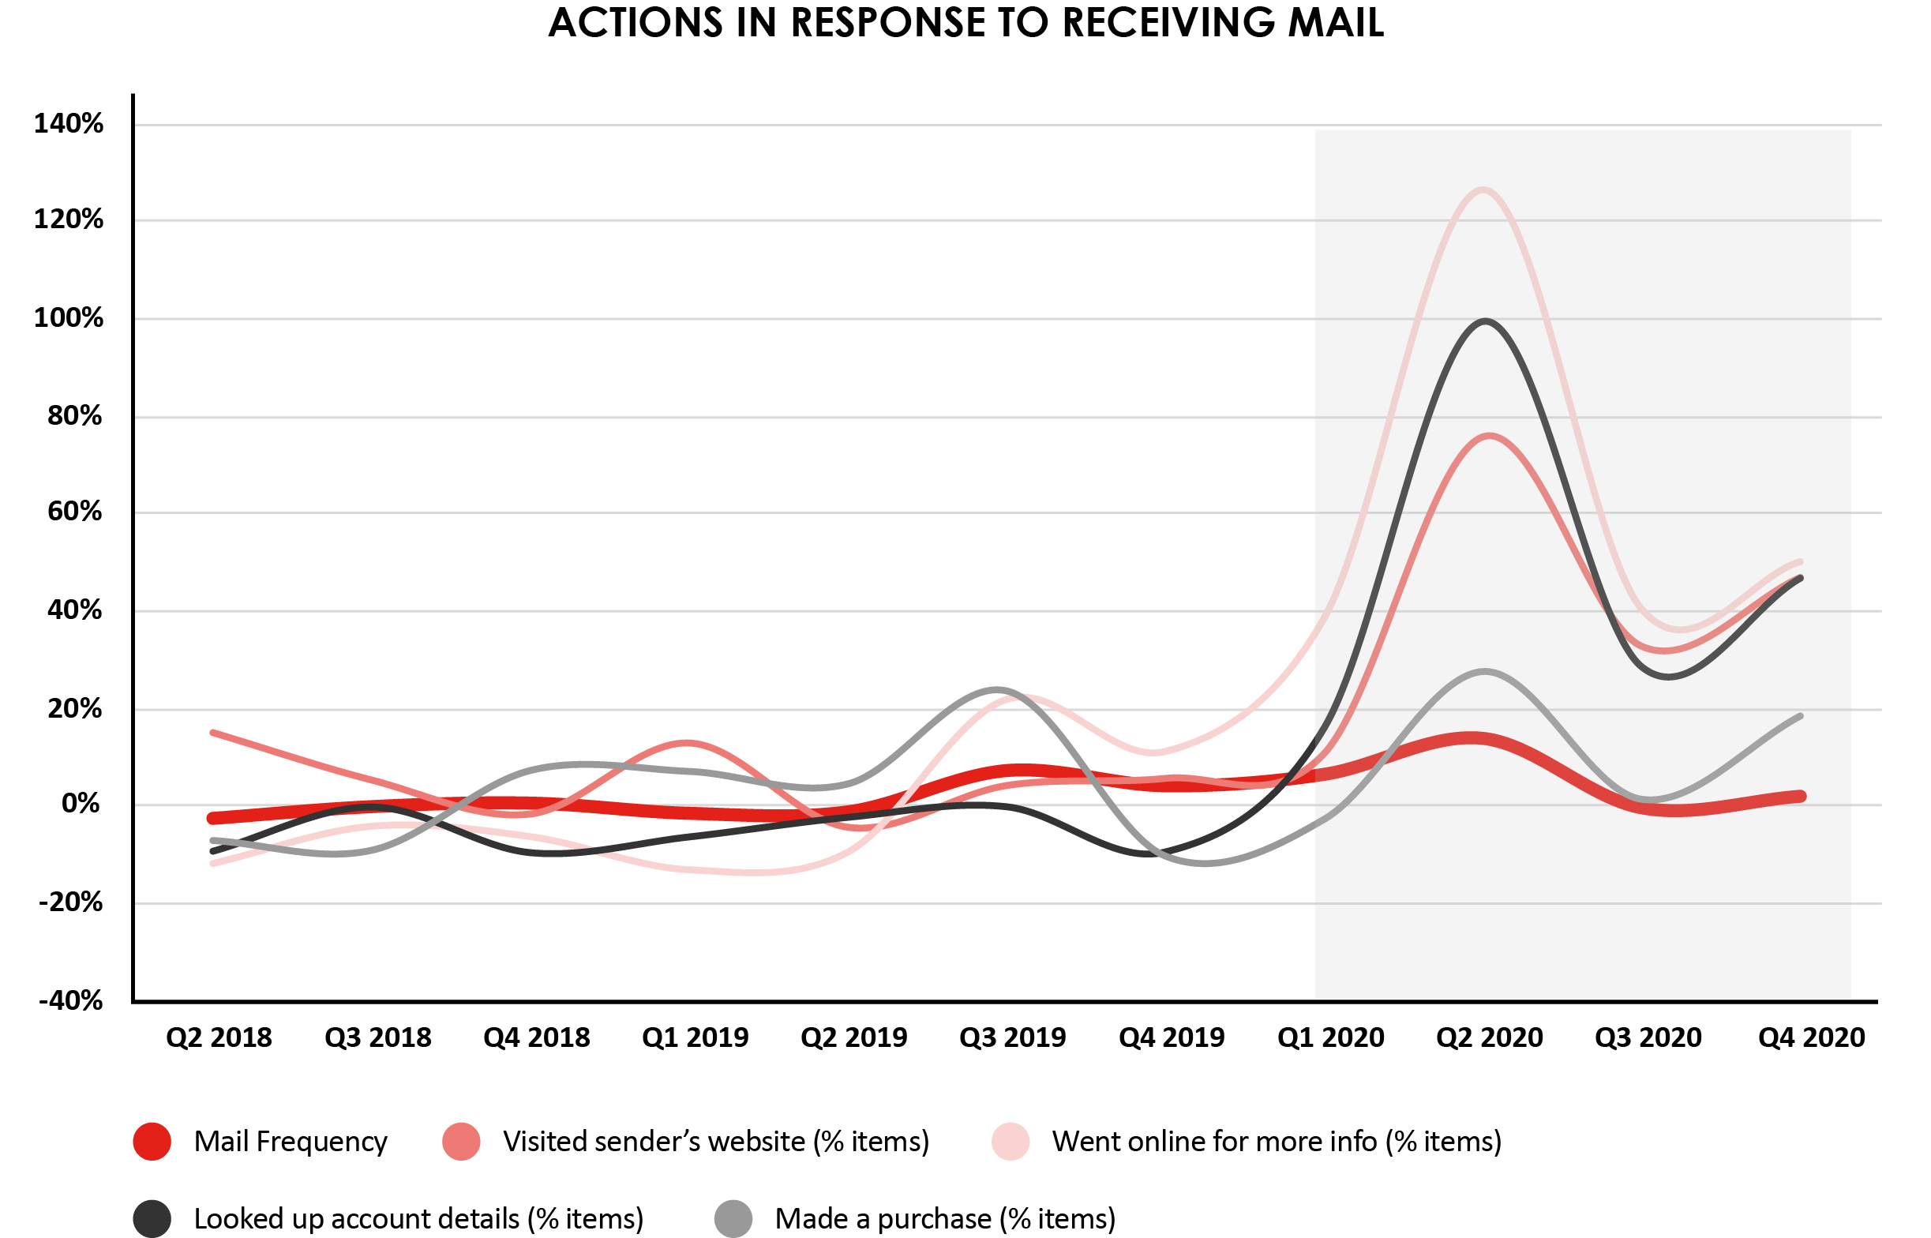
2020 Was the year of mail effectiveness

Slide 3
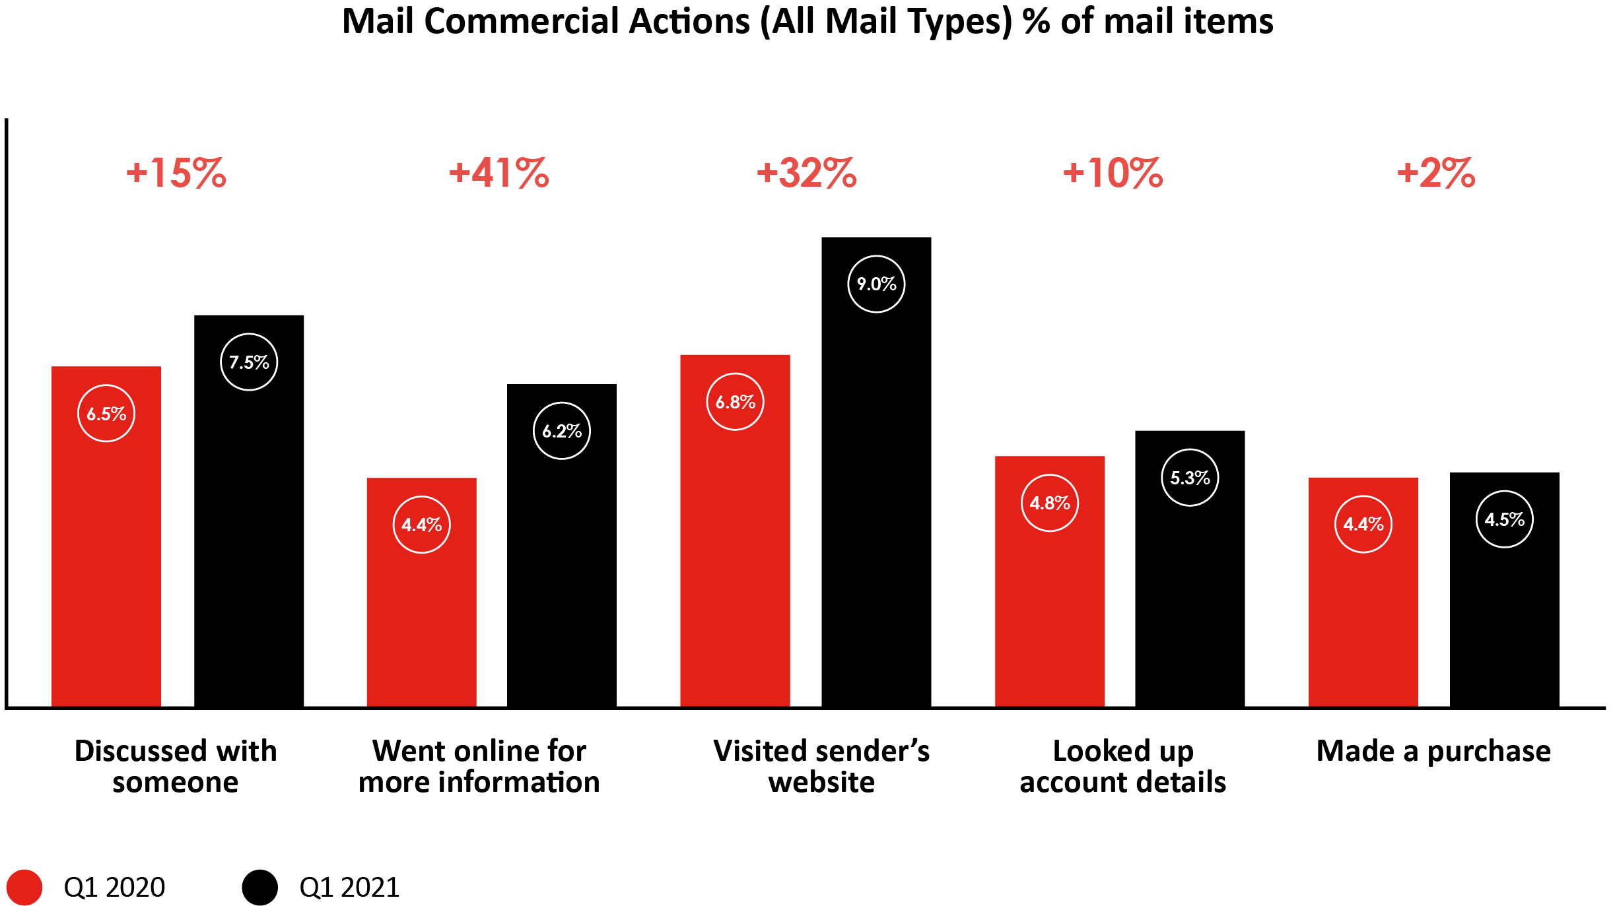
Mail effectiveness up year on year

Slide 4
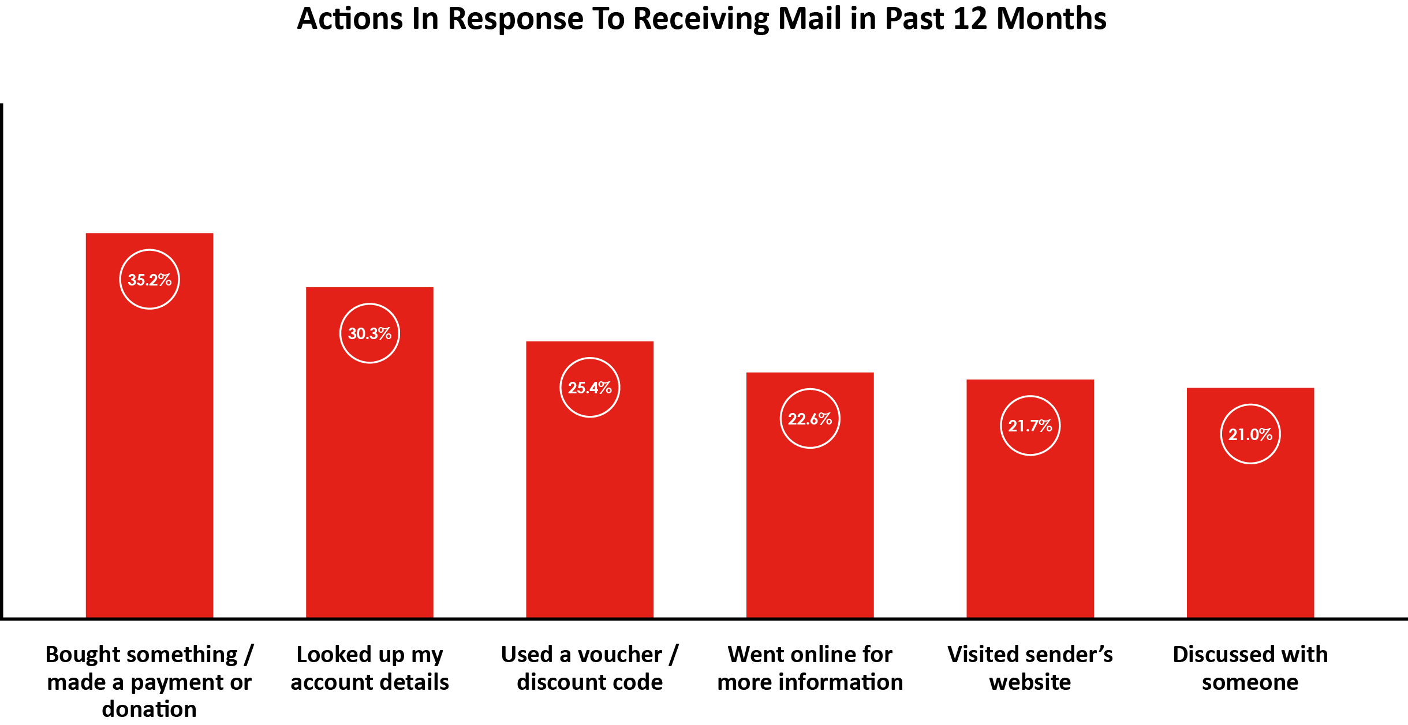
Mail drives commercial outcomes
Discussion, digital and buying behaviours

Slide 5
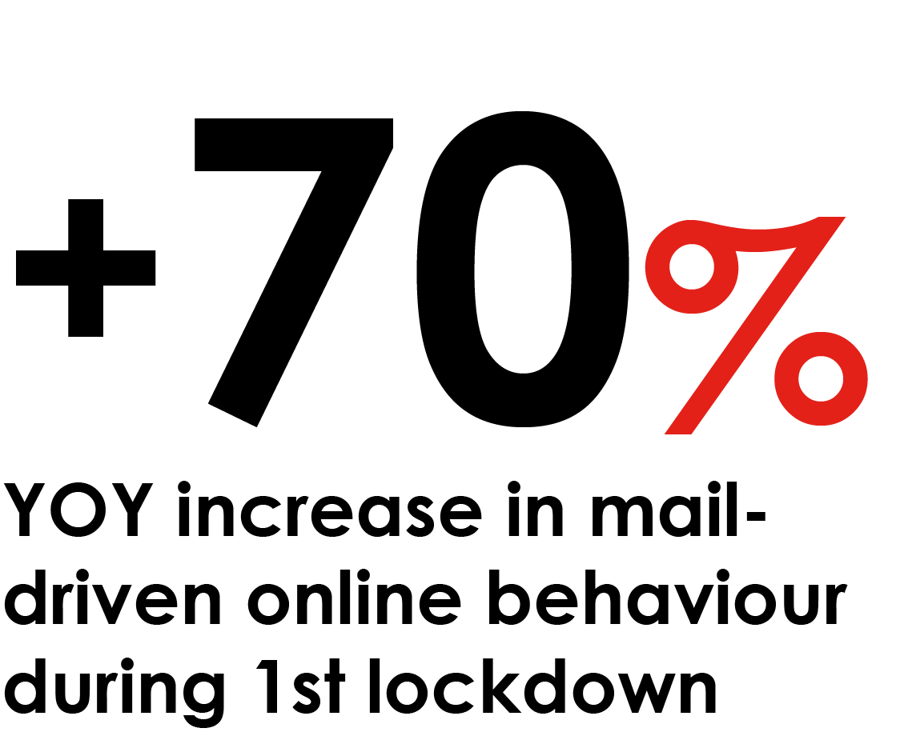
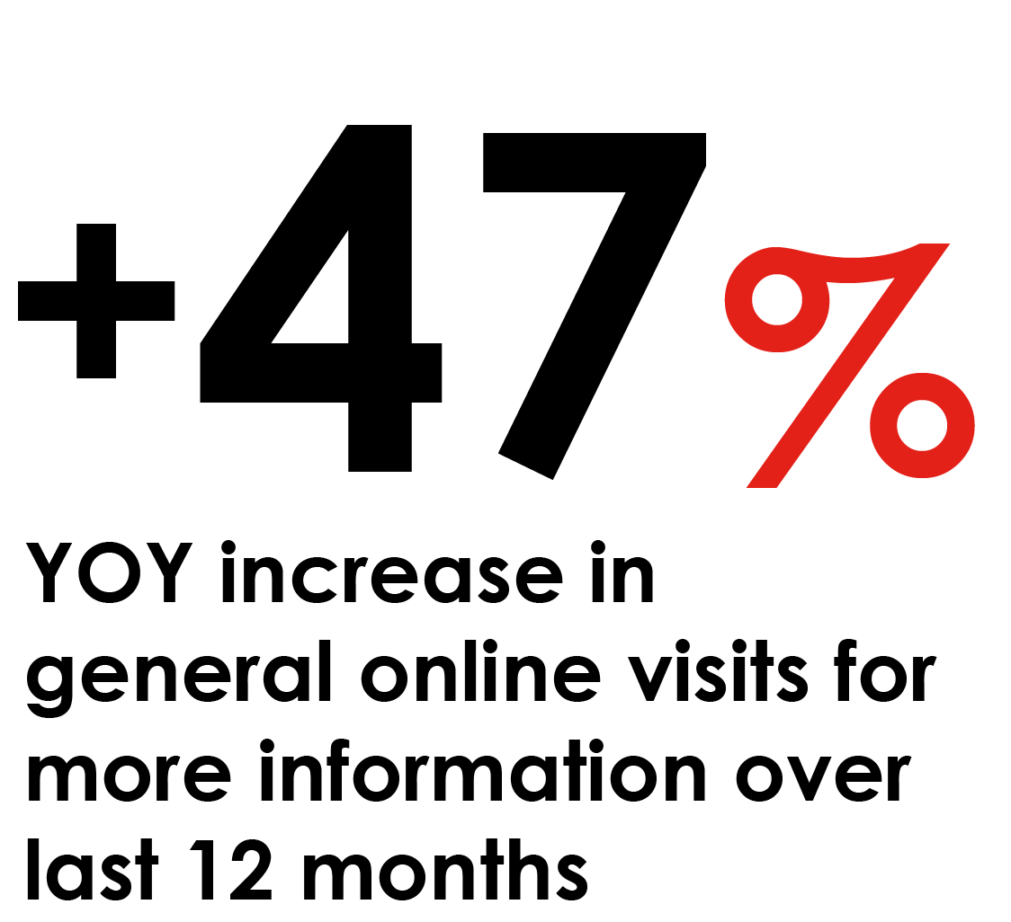
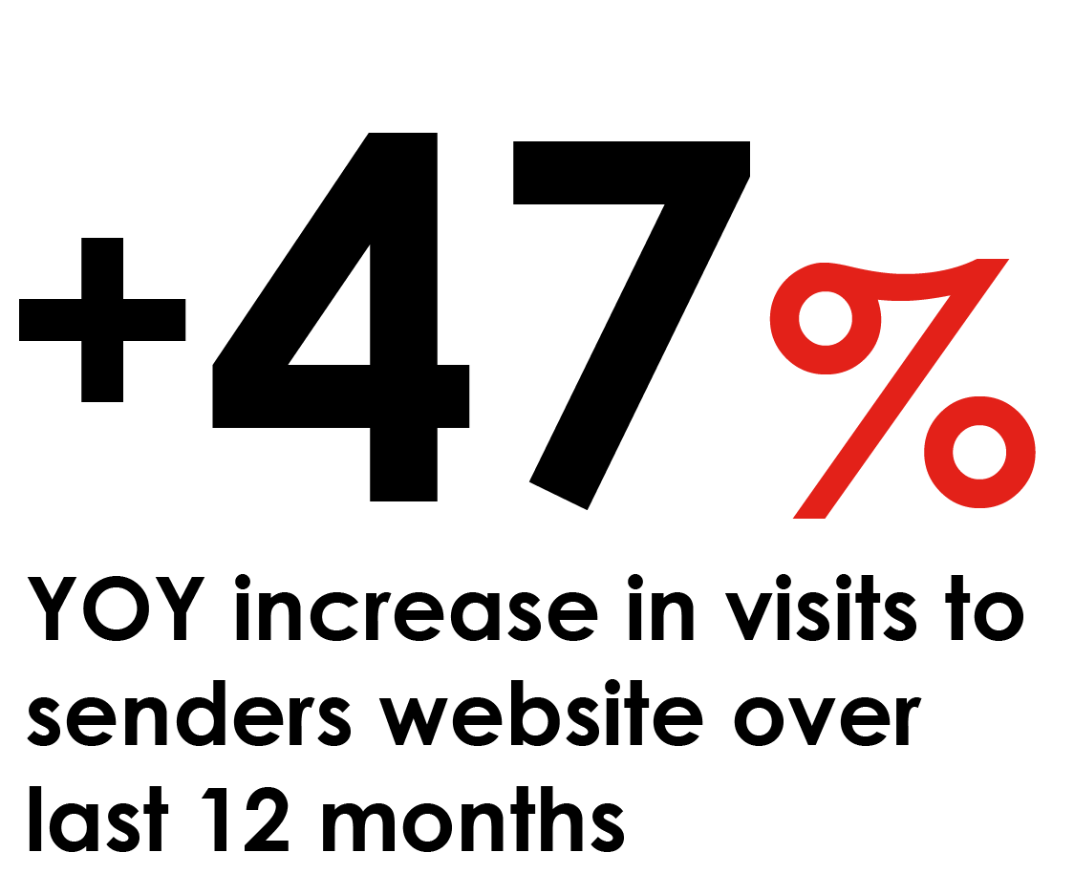
Mail drives Digital
Digital actions prompted by mail have grown during the pandemic

Slide 6
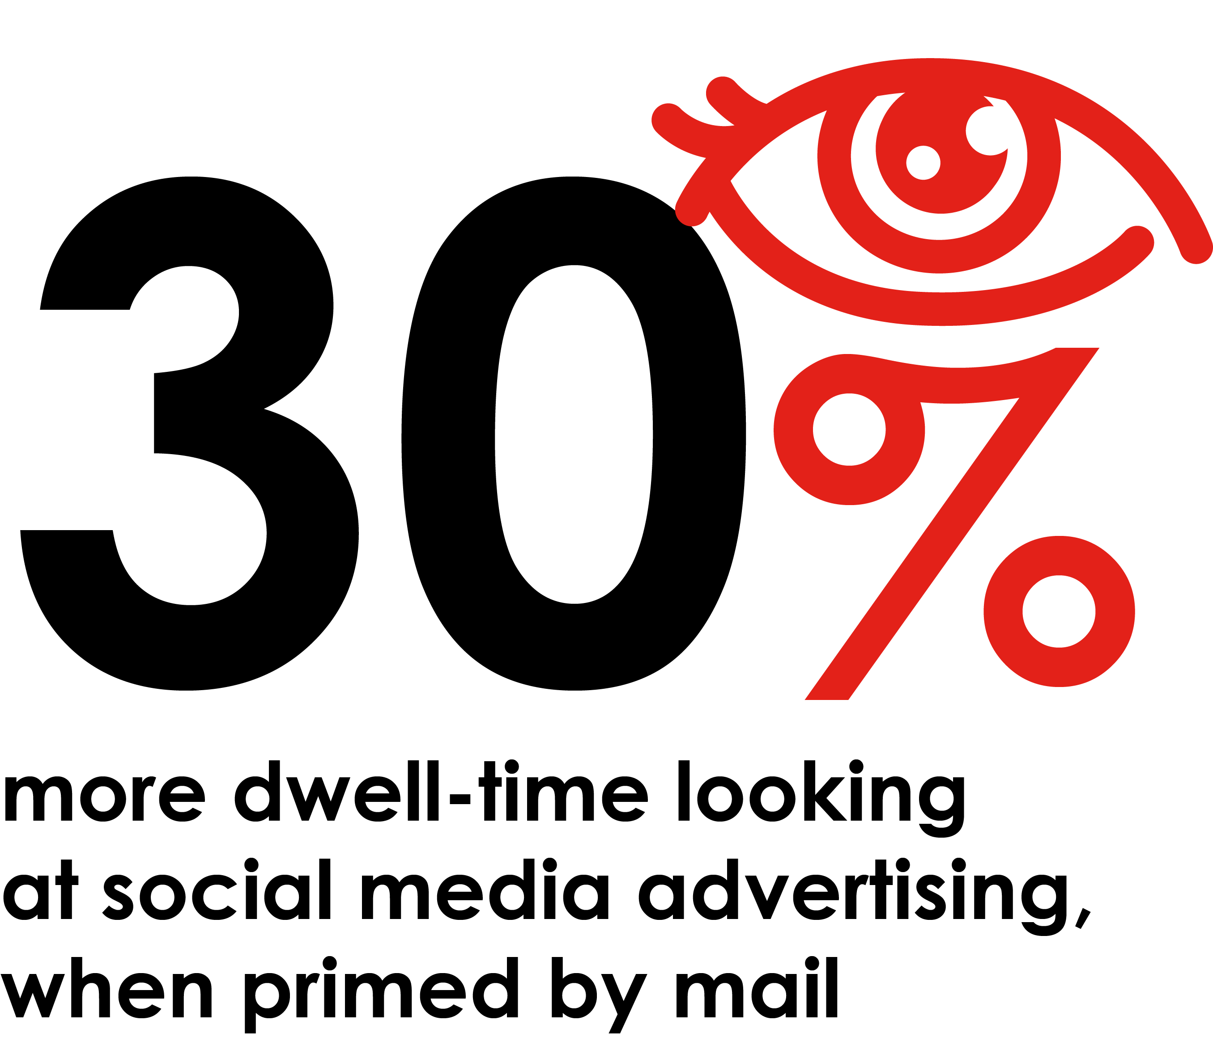
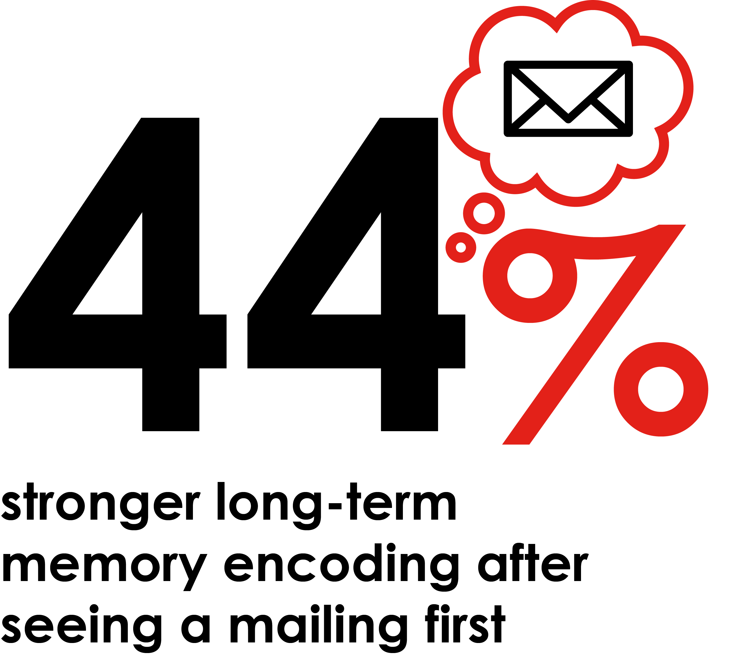
Mail has a priming effect on social
Making Facebook ads more attention-grabbing and memorable

Slide 7
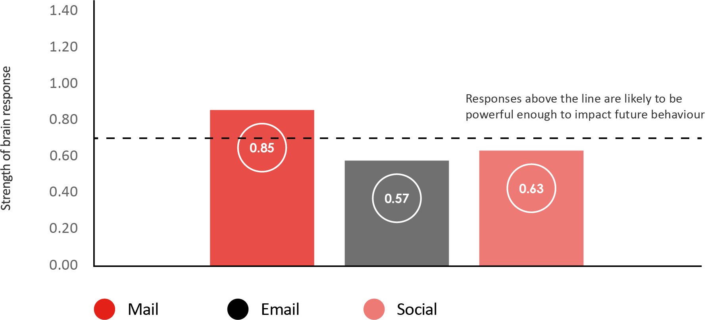
Neuroscience confirmed mail makes a longer lasting impression than social media ads
Brain response to mail, email and social advertising in the neuroscience study
This indicates that people are more likely to remember brand communication that is delivered by mail

Slide 8
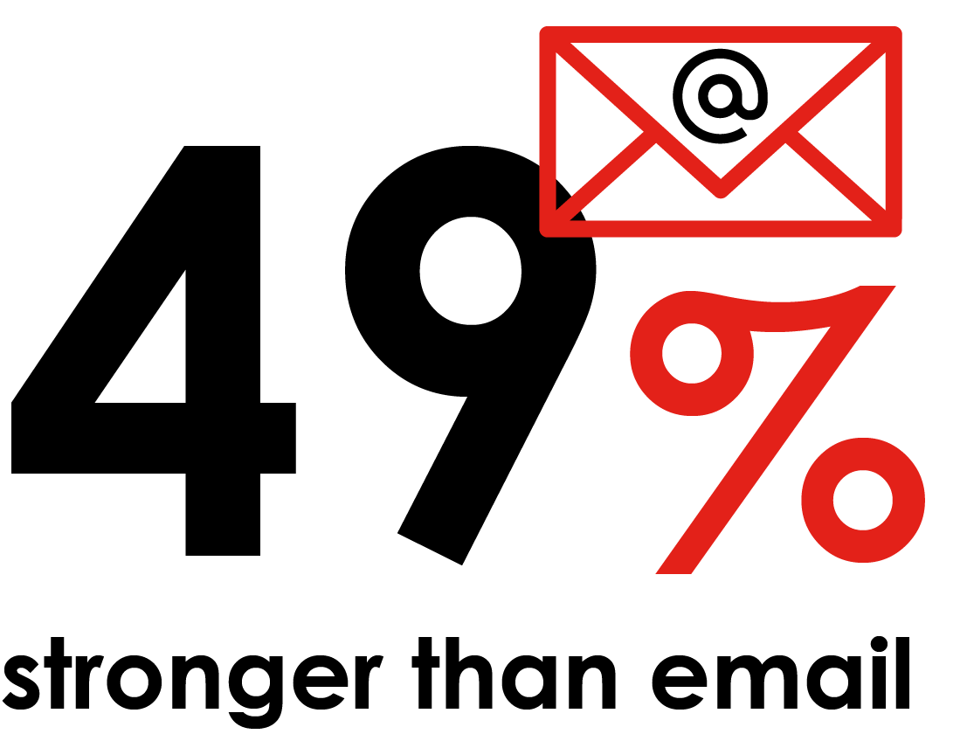
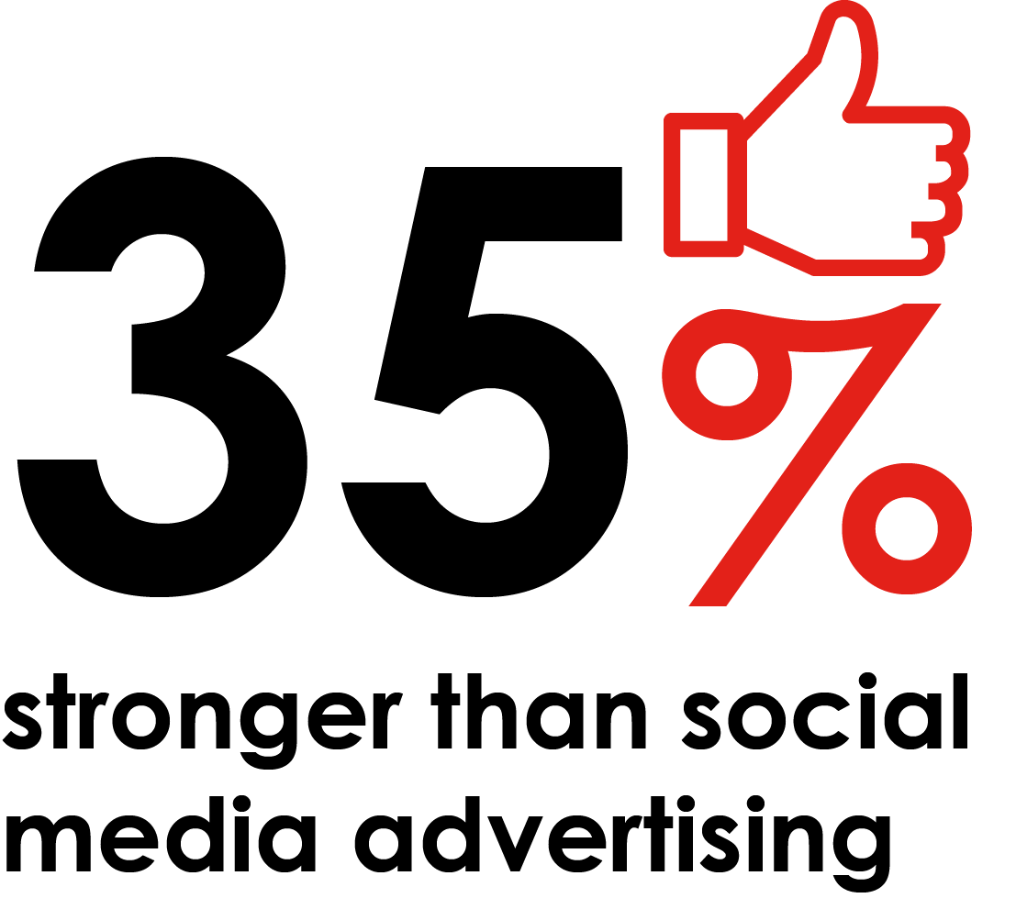
Neuroscience confirmed mail makes a longer lasting impression than social media ads
Mail has more powerful impact on long-term memory encoding
Research has shown long-term memory encoding is strongly related to decision-making and purchase intent.
Long-term memory encoding : the extent to which the brain is storing the information it’s getting from the stimulus, for later use.
Social media advertising tested was a single-image ad with text, appearing in participants’ Facebook news feed .

Slide 9
THANK YOU
www.marketreach.co.uk

