Slide 1
BRAND-BUILDING OR PERFORMANCE MARKETING? WHY NOT HAVE THE BEST OF BOTH WORLDS.

Slide 2
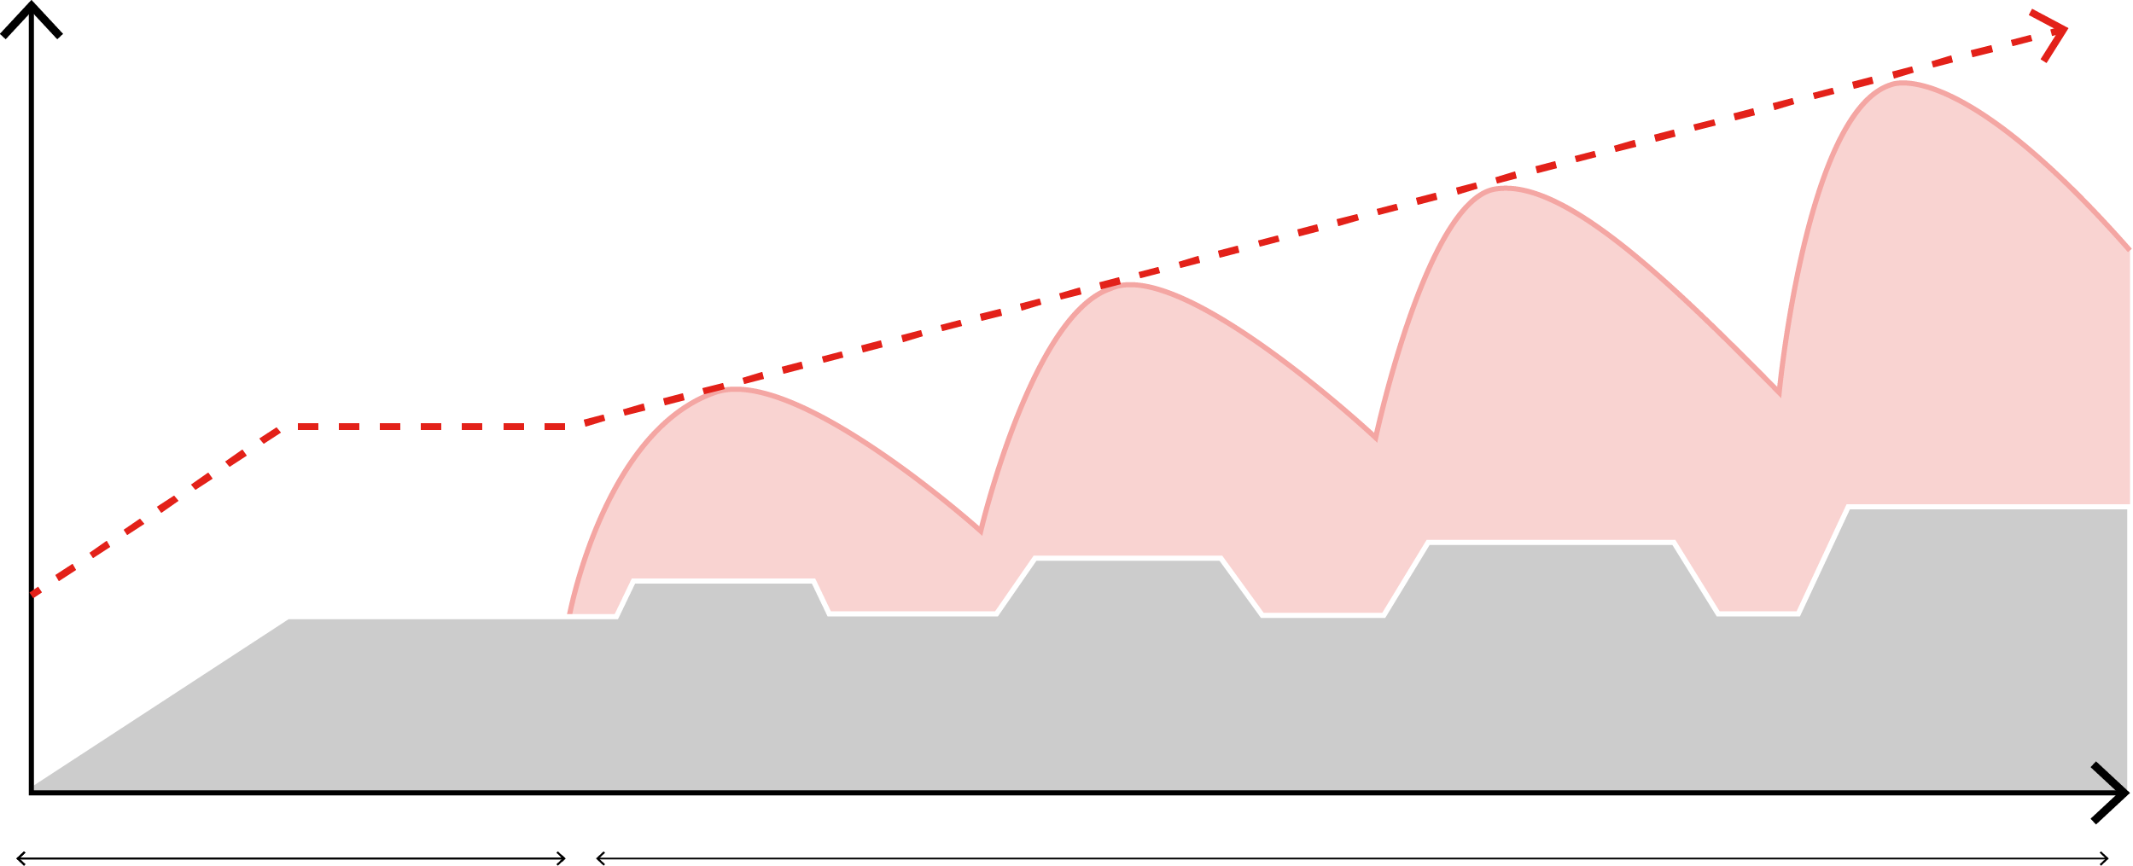
Combining the power of short and long-term effects to improve brand performance
Incremental Sales
Brand-building
Sales activation
Time
Growth from scale-up of always on sales activation activity, but this is limited
Growth from both sales activation and brand-building activity, with the two working together and improving over time

Slide 3
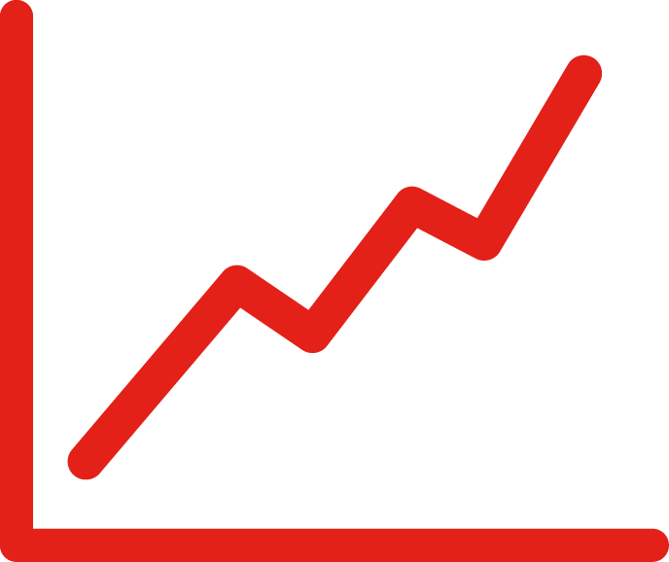
MAIL SUPPORTS BOTH BRAND & PERFORMANCE
Whatever your objective, mail drives the right response
Whether your brand takes a 60:40, 50:50 or 70:30 approach to short-term activation/long-term success, putting your brand into customers’ hands using mail is highly effective.
Improved methods of attribution using QR codes, personalised URLs (PURLs) or unique online codes provide a more accurate direction on response to tackle last-click inaccuracy.
The effectiveness of mail can also be evaluated to measure long-term brand success and ROI.
Re-framing your strategy with mail media can generate short-term
effects like immediate online sales,
with longer-lasting effects like memorability, fame and enhanced LTV.

Slide 4
Opportunities for mail to build brands and relationships across the Customer journey
Establish consideration and trust
Cross sell services to strengthen choice
Maintain focus on needs on going
Retention and advocacy
Educate and build awareness
Welcome and create relationships
Build relationships and trust further

Slide 5
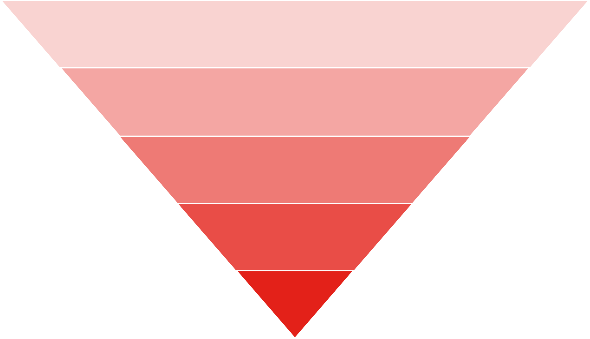
Utilise everything in your toolkit
Test & learn which channels are effective at different stages of the funnel
Awareness
Interest
Desire
Action
Loyalty
An integrated through-the-line approach delivers the best results, and mail enables you to collect first-party data and generate a new prospect pool for multi-channel re-targeting

Slide 6
“In home” media plan reaches 2.5M people WFH 5 days a week – budget £2.5M
SCHEDULE 1
GPRs
TV: 315
Social: 693
Radio: 402
Work from home 5 days a week
2.5 mill reach
94.2% reach
Budget: £2.5 mil
37.4 mill impacts
14.9 av. frequency
£66.82 CPM
80.8% 3+ frequency

Slide 7
Diverting 23% of budget to dm increases reach by 4%, but CPM also increases 2%
SCHEDULE 1
SCHEDULE 2
GPRs
TV: 315
Social: 693
Radio: 402
GPRs
TV: 234
Social: 528
Radio: 347
DM: 273
Work from home 5 days a week
2.5 mill reach
94.2% reach
2.6 mill reach
+4%
98.0% reach
+4%
Budget: £2.5 mil
37.4 mill impacts
14.9 av. frequency
36.7 mill impacts
-2%
14.1 av. frequency
-5%
+2%
91.6% 3+ frequency
+13%
£66.82 CPM
80.8% 3+ frequency
£68.12 CPM

Slide 8
However, significant efficiencies found in the effective frequency range – CPM decline 22%
SCHEDULE 1
SCHEDULE 2
GPRs
TV: 315
Social: 693
Radio: 402
GPRs
TV: 234
Social: 528
Radio: 347
DM: 273
Work from home 5 days a week
2.5 mill reach
94.2% reach
2.6 mill reach
+4%
98.0% reach
+4%
Budget: £2.5 mil
37.4 mill impacts
14.9 av. frequency
36.7 mill impacts
-2%
14.1 av. frequency
-5%
+2%
91.6% 3+ frequency
+13%
£66.82 CPM
80.8% 3+ frequency
£68.12 CPM
Frequency 6 to 10
27% of reach
£479
33% of reach
+14%
£373
-22%
Frequency 4 to 8
31% of reach
£557
35% of reach
+13%
£463
+17%

Slide 9
THANK YOU
www.marketreach.co.uk

