Slide 1
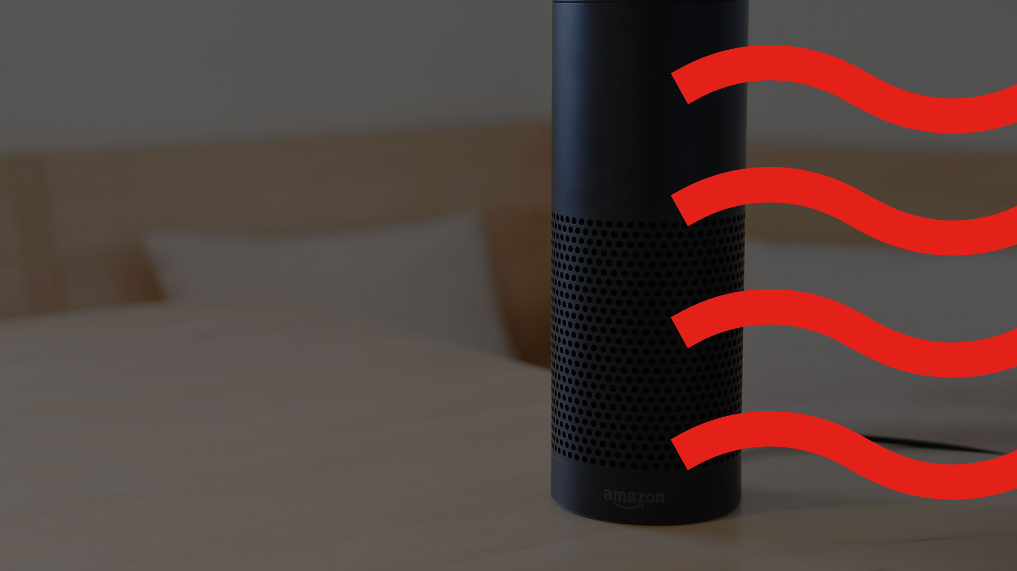
VOICE

Slide 2
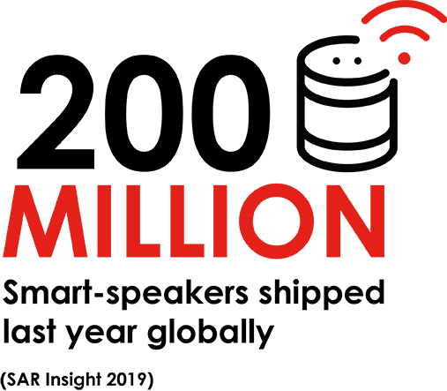
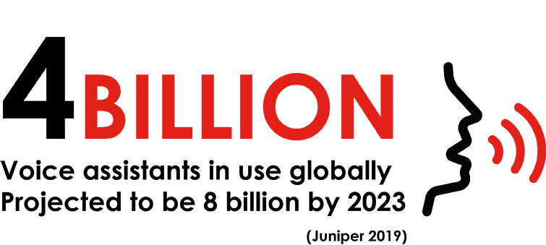
Voice is a billion person platform

Slide 3
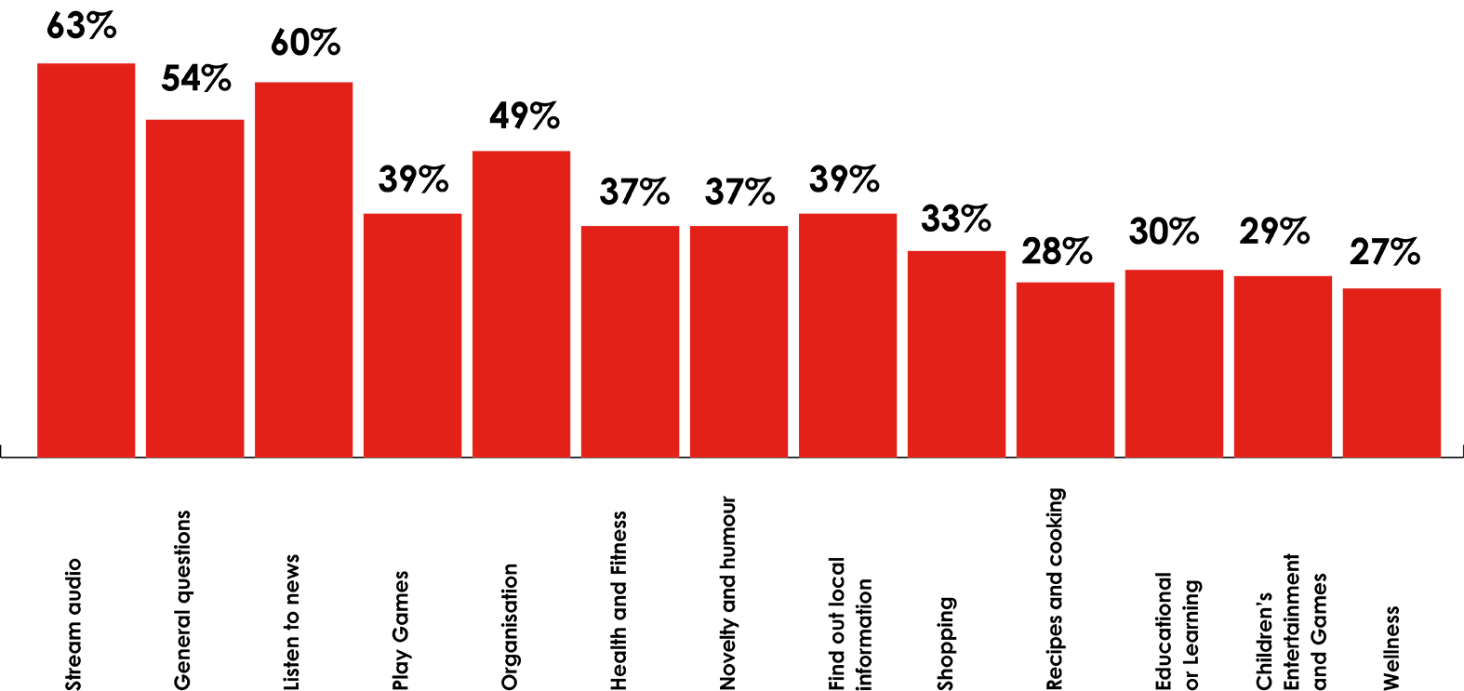
HOW CONSUMERS ARE USING VOICE
Source: JICMAIL Item Data Q1 2021 n=11,893 Door Drops, DM and Business Mail items

Slide 4
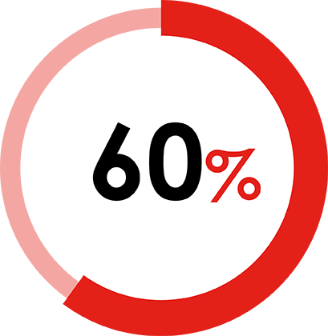
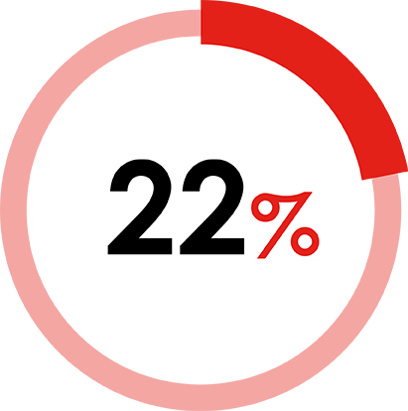
A SEAMLESS LINK TO PURCHASE
Six out of ten smart speaker owners have used them to make a purchase in the past year
Nearly a quarter said they have used a smart speaker to purchase in the past week
Source: Artefact (AI Agency), August 2019

Slide 5
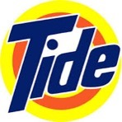
THERE ARE HUGE POSSIBILITIES
Allowing customers
to get balances via Google Home devices
Amazon using information from the NHS to provide answers to questions like, "How do I treat a migraine?"
During Prime Day event Amazon allowed Prime subscribers to access best offers through Alexa
Ask Alexa to track your parcel
Order your pizza and then re-order with your saved profile
Ask Purina about products and dog queries generally
Get advice on stain removal and order more product
Access 160 Jamie Oliver recipes on Alexa
Source: Artefact (AI Agency), August 2019

Slide 6
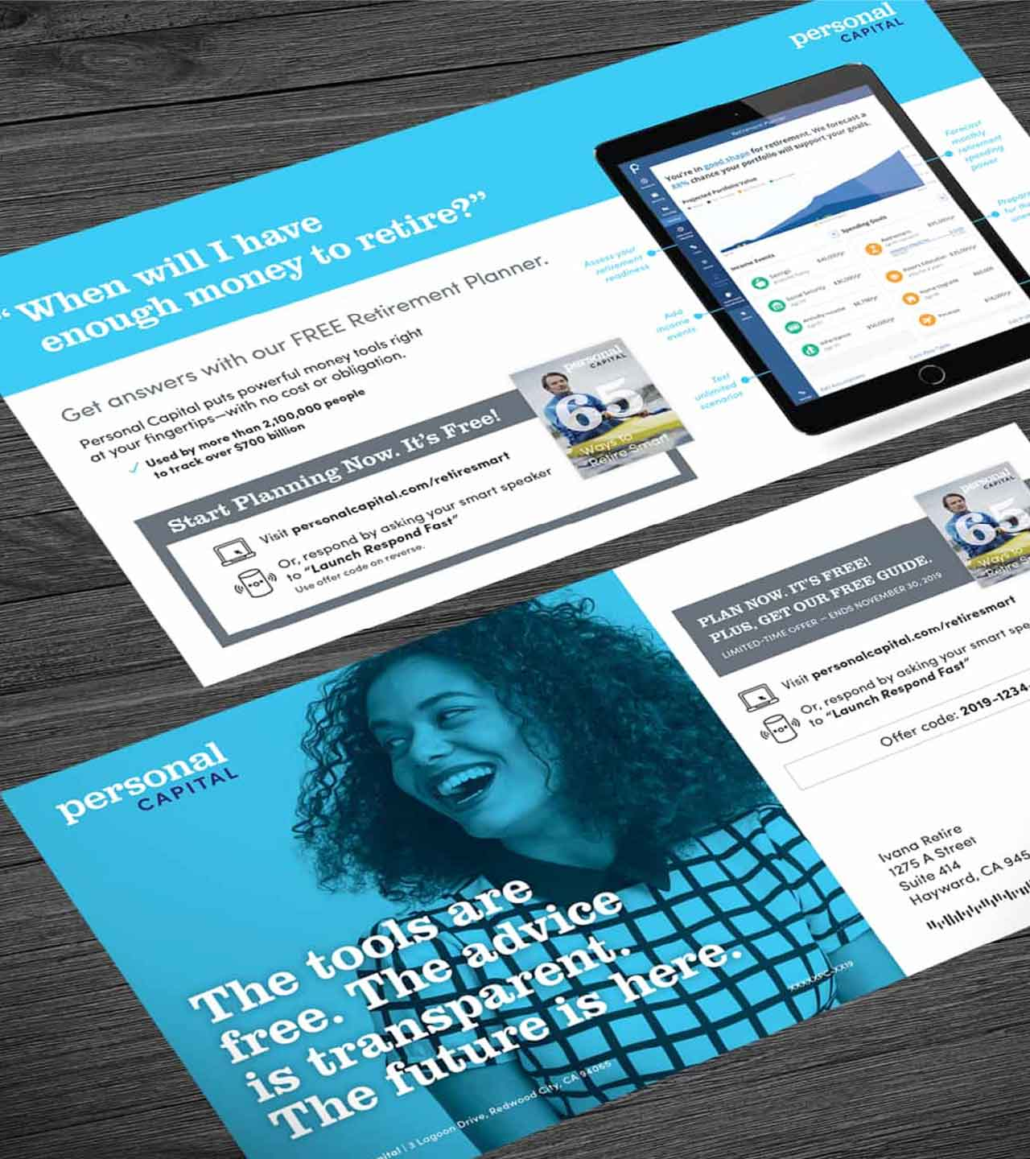
Voice activation & direct mail
Personal Capital, based in San Francisco use voice activation to generate leads for their retirement services.
Activated by a smart speaker, simply tell them your mobile number and they text you further info on how to get your guide to retirement planning.
This directs you to a link.
No attribution problems, easy and seamless for the customer to interact.
Source: Gunderson Direct, USA

Slide 7
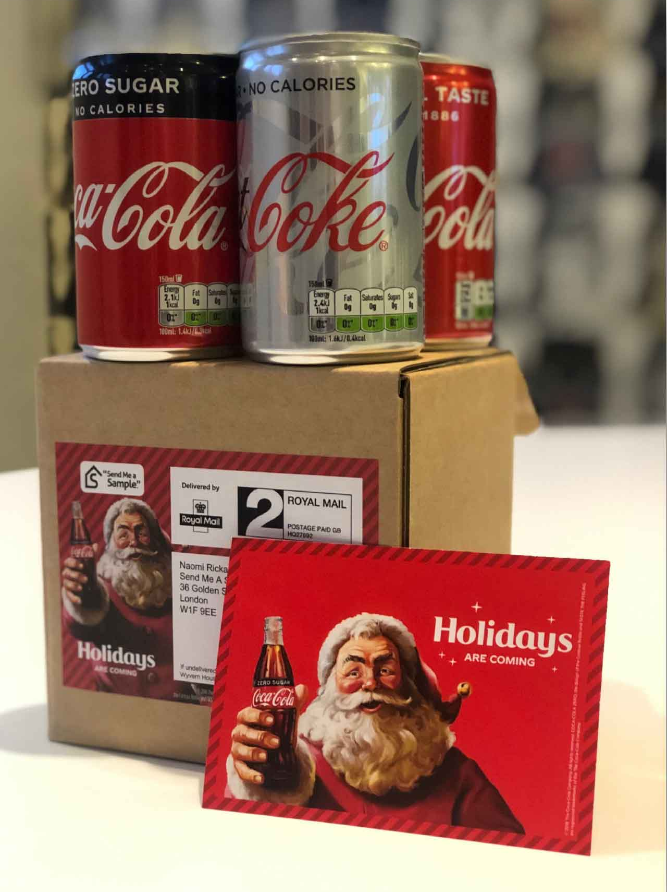
GETTING PRODUCT INTO THE RIGHT HANDS
Send me a sample - UK
Coca Cola knows that if they can get consumers to trial a product, they are significantly more likely to buy
But normal street sampling is a wasteful way of getting samples in the hands of consumers
Using TV advertising to target a family audience a 10 second tail was added to the main ad, saying “Get four cans of Diet Coke Exotic Mango sent your home for free. Just say to your voice assistant, ‘Ask Send Me a Sample for a Diet Coke’.”
Four cans were sent to those requesting so all the family could enjoy sampling
40% conversion to purchase
45% opt-ins to ongoing communications from Coca-Cola
Opt-in data of highly engaged people who had responded to the advertising
Source: Gunderson Direct, USA

Slide 8
HOW THIS WORKS IN MAKING A REQUEST
Activate Advertising Message
Consumer Requests Sample
Sample Is Delivered
Opt InData Is Shared

Slide 9
THANK YOU
www.marketreach.co.uk

