Slide 1
PROGRAMMATIC MAIL – CUSTOMISABLE, MEASURABLE AND NEAR - INSTANT

Slide 2
“
Programmatic mail combines online and physical channels in a way that is likely to significantly improve ROI.
Mark Cripps, CMO
”
Source: Emailmonday “The Ultimate Marketing Automation Stats” (2019)

Slide 3
SO, DOES IT WORK?

Slide 4
IT CAN FULFIL MULTIPLE OBJECTIVES FOR BRANDS
From offline retargeting to lifecycle management
Browse Abandonment
Quote Abandonment
Next Best Product
Email Non-Responders
Email Non-Permissible
High Value Customers
Customer Milestones
Lapsed Customers

Slide 5
The end-to-end campaign process
Programmatic mail
Brand X determines & agrees campaign objective with programmatic mail partner
Programmatic mail partner sets up tagging on Brand X website
Brand X 1st party data uploaded to a portal
Customer behaviour triggers timely, relevant & personalised mailing
Programmatic mail partner, reports on performance with detailed campaign analytics
OR
Tags capture customer information prior to abandonment

Slide 6
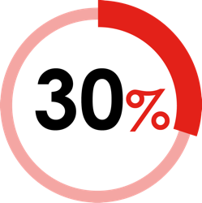
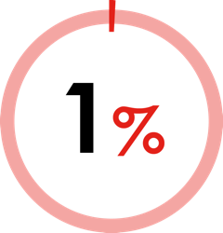
LEVERAGE YOUR FIRST-PARTY DIGITAL DATA
To activate more effective outcomes
90% of marketers say that first-party data is important to their marketing
But only 30% are collecting and integrating data across channels
Only 1% are using data to deliver a fully cross-channel experience for their customers
USING FIRST-PARTY DATA COMES WITH BUSINESS BENEFITS
up to
up to
2x
1.5x
incremental revenue
(from a single ad placement, communication, or outreach)
improvement in
cost efficiency
compared to companies with limited data integration
Source: Google / Boston Consulting Group, Responsible Marketing With First-Party Data 2020

Slide 7
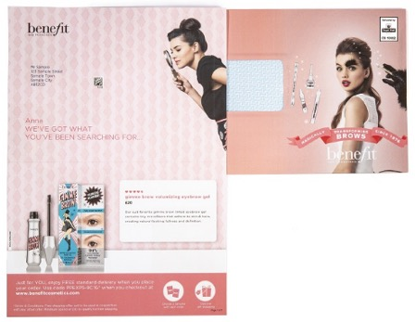
Retargeting WITH PROGRAMMATIC DM DROVE SUBSTANTIAL UPLIFT IN SALES FOR BENEFIT
BACKGROUND
SOLUTION
RESULTS
Leading women’s cosmetics brand, Benefit, had noted a high volume of web visitors who were only browsing products - not purchasing. With a growing range of eyebrow products being added to the product range, the company wanted to focus specifically on increasing conversions within that range.
Paperplanes partnered with Benefit to programmatically trigger personalised letters to be sent to customers that browsed the eyebrow product section of the website, but didn't make a purchase. The letters were designed to encourage customers to complete a purchase on the specific product they viewed, promoting free delivery for the customer to strengthen conversions. Unique shipping codes were applied to each individualised letter to track and monitor performance. The creative comprised of a double sided, full colour print A4 letter and a full colour C5 envelope with smart use of personalisation across both for maximum impact, brand recognition and awareness.
Campaign results revealed a 37% uplift in sales conversion of eyebrow products online with an average customer value of over £40. Results from the campaign also revealed that engagement levels had risen to over 28%.

Slide 8
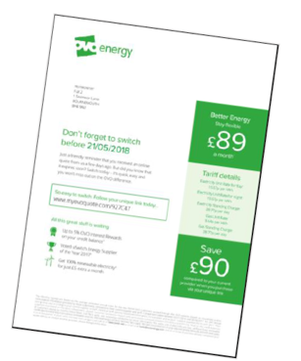
OVO ENERGY GENERATED AN ROI OF 15:1
From customers interested in energy services
BACKGROUND
SOLUTION
RESULTS
OVO is one of the fastest growing independent energy providers in the UK. When customers started a quote on the OVO site, but didn’t complete the buying process, they received a follow up email. Retargeted emails had a good return but it had become difficult to further improve the performance.
OVO partnered with Paperplanes to target non-converters with highly personalised programmatic direct mail. Mail retargeted and encouraged them to complete their energy switch, providing quote details they abandoned. The mail, delivered in 24-48 hours, was able to offer the same level of personalisation as email.
The campaign led to strong incremental uplift and ROI - £15 for every £1 invested. 5.5% overall conversion rate representing a 25% incremental uplift on conversion vs lookalike customers, and strong performance vs digital retargeting. The campaign continued to generate strong conversions well past the typical sales cycle of a 7 day quote, with uplift still noted up to 30 days after the campaign’s end.

Slide 9
THANK YOU
www.marketreach.co.uk

