Slide 1
AUTOMATION

Slide 2
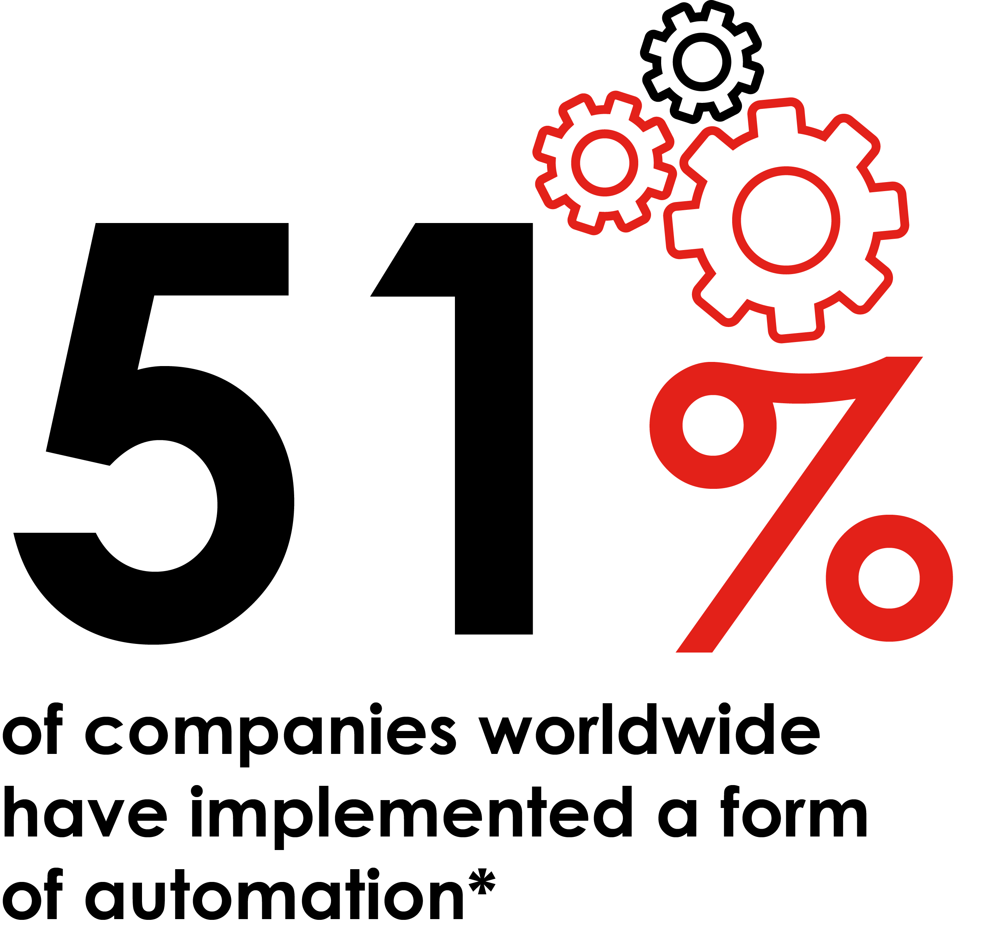
The age of automation
Mail automation can play an important role in marketing & CRM activity
Now you can automate the mailing process in the same way you can with digital – driving measurable results more holistically alongside other channels.
This approach enables you to engage with customers who are unresponsive, whilst driving down costs and booting speed of activation.
Leverage your first-party data to trigger personalised communications in a single view SaaS environment with social, email, SMS & push.

Slide 3
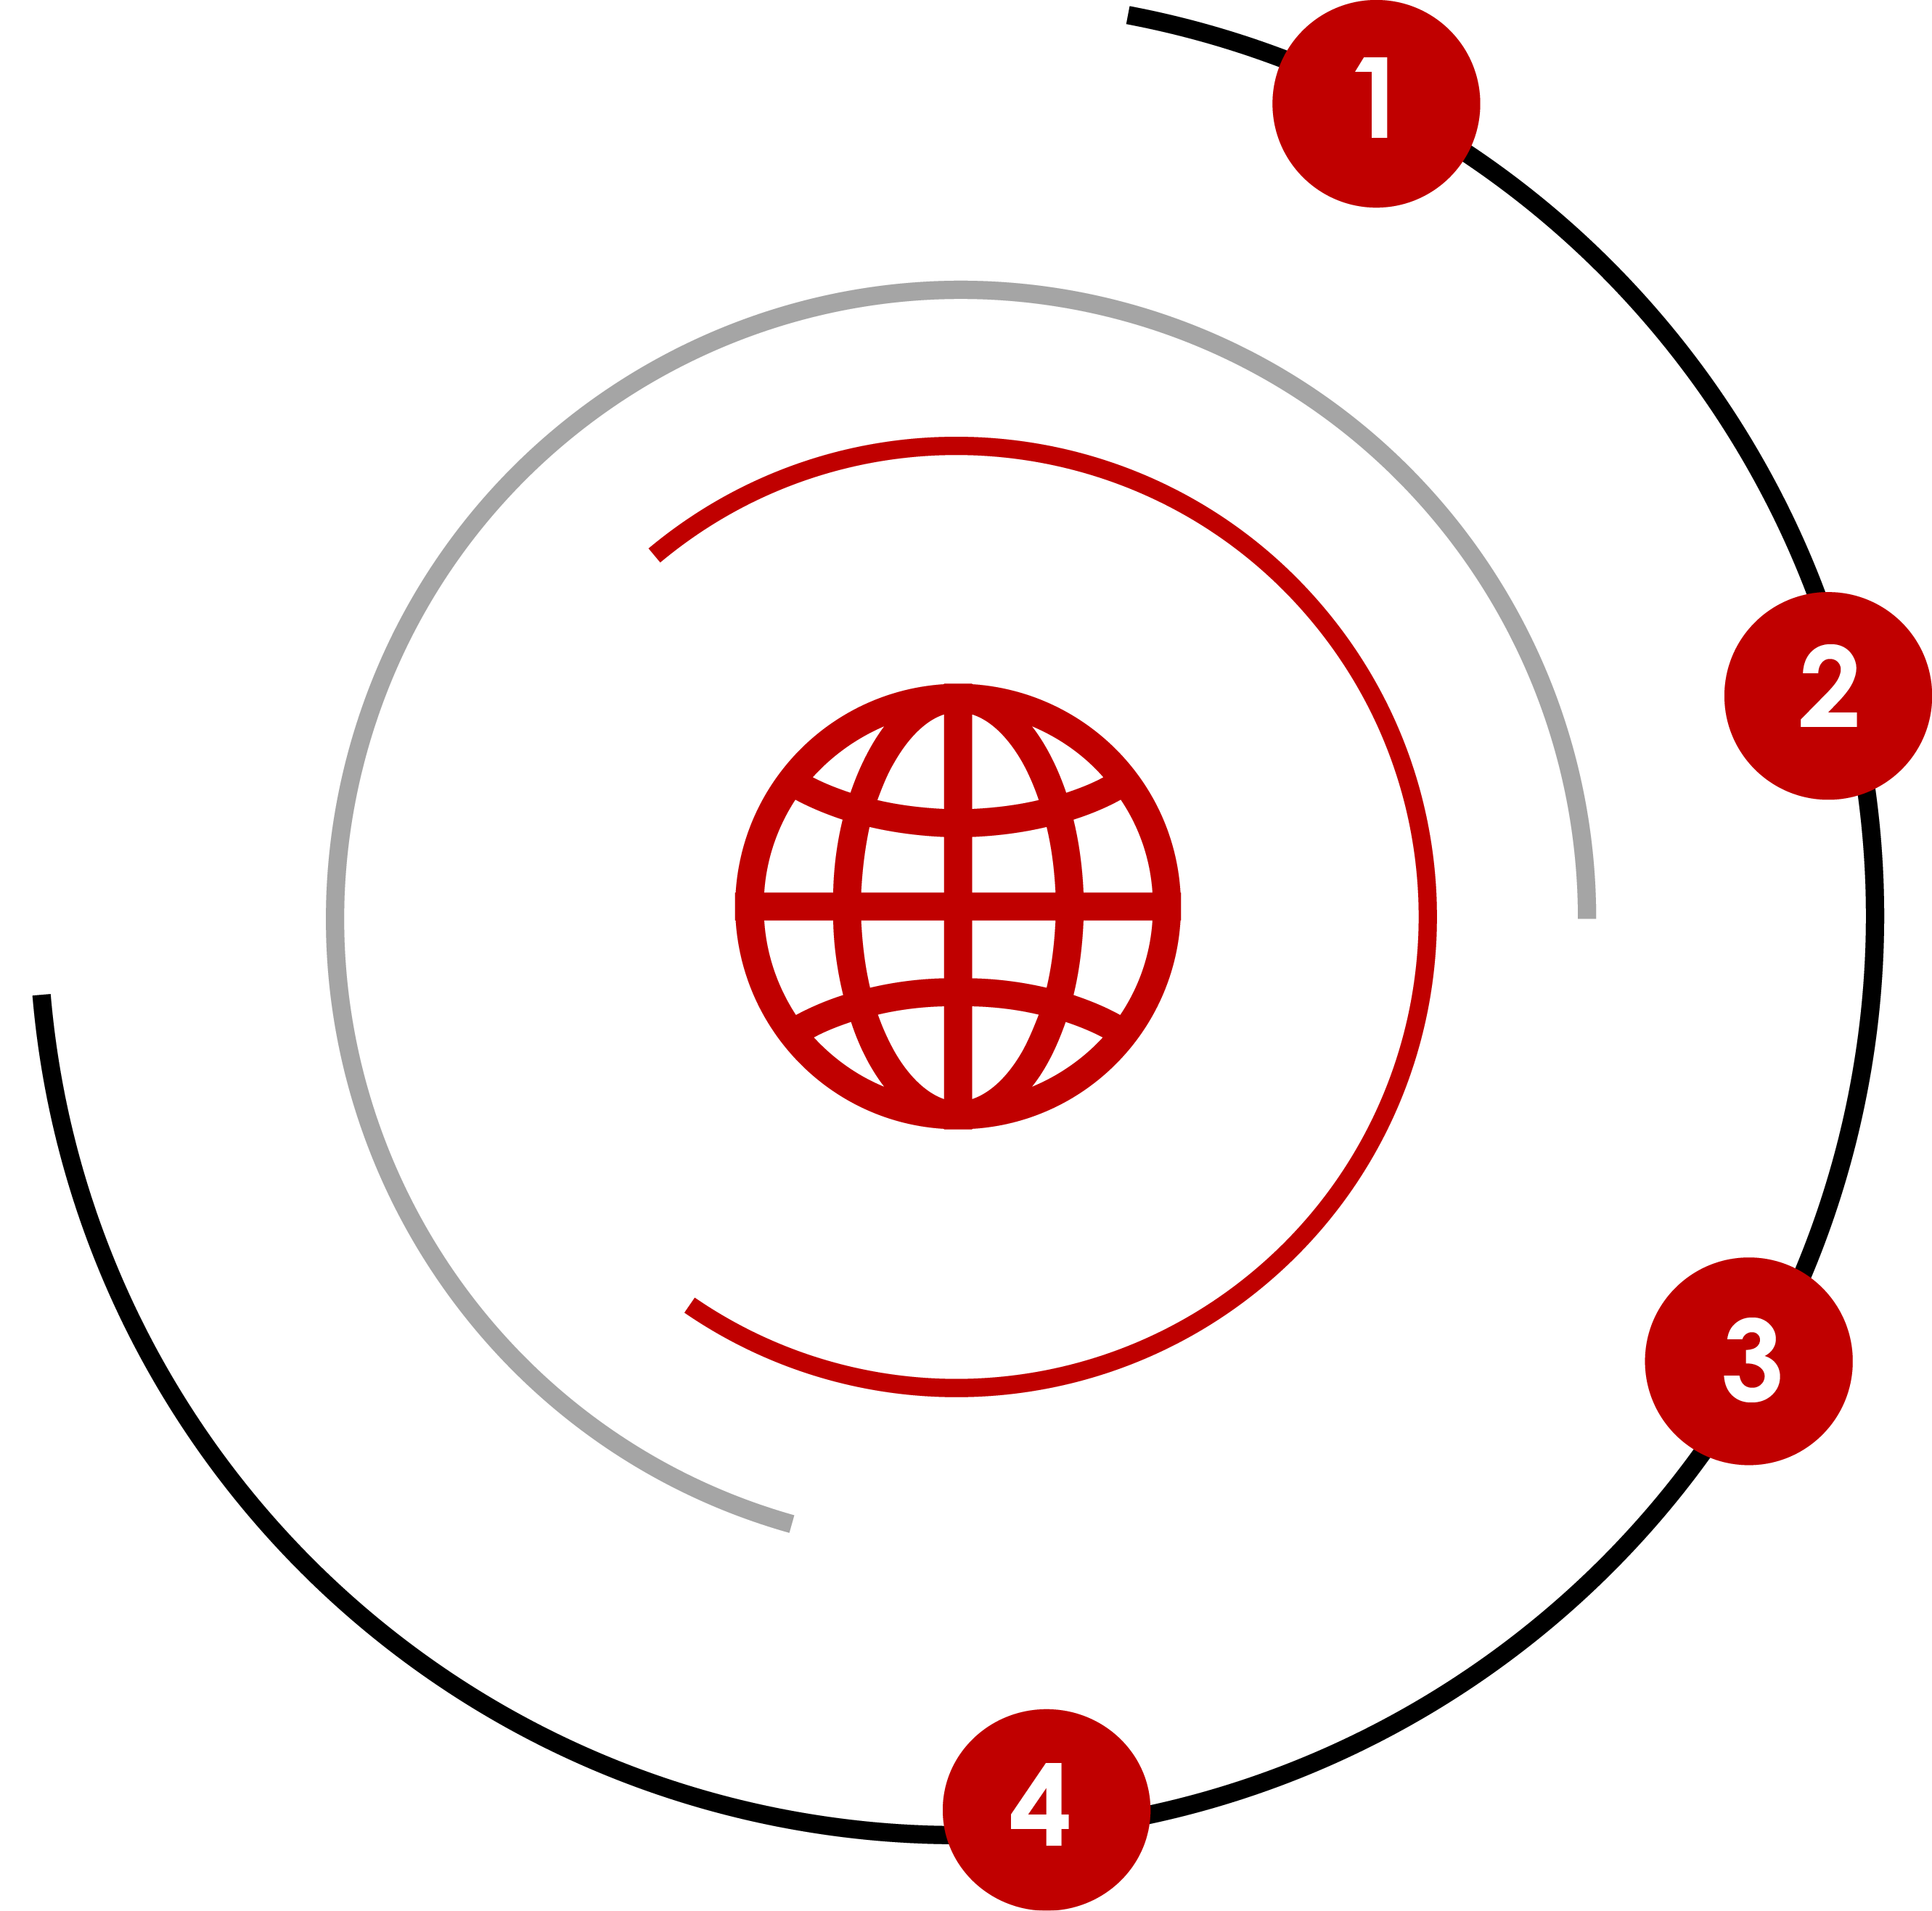
Mail is now easy to integrate in your mix
Mail automation can play an important role in marketing & CRM activity
Integrate with your marketing stack
Automate direct mail across the customer lifecycle with no manual processes, batching or CSV uploads. Integrate with your marketing tools to dynamically trigger direct mail based on customer profile, behavior or milestone
Design quickly and reuse digital assets
HTML templates let you easily reuse designs and content across campaign channels without proofs, approvals or rigid formats
Personalise your direct mail
Customise content, imagery and layout for each piece of mail you send to create meaningful engagement and drive conversions and print it
Easy to experiment and optimise approach
All automation platforms can give you complete visibility of production and delivery and match back to your data

Slide 4
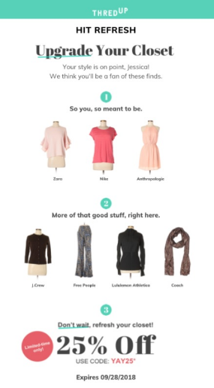
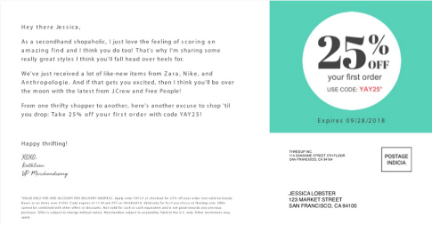
US e-commerce platform used mail
A cost-effective alternative to digital platforms
BACKGROUND
SOLUTION
RESULTS
thredUP, a San Francisco-based e-commerce platform for buying and selling secondhand clothing, was looking for a way to reactivate high-value, VIP customers that hadn’t completed a transaction with them in the last 30 days. Like many digital-first enterprises, they had used Google and Facebook as channels for reaching people in the mood to shop, but the associated CPC or CPM varied dramatically - depending on the time of year, what trends were popular, and so on.
In partnership with Lob, a programmatic mail specialist, thredUP utilised it’s CRM data to trigger highly personalised postcards based on the lack of engagement from their VIP customers within the 30 day period and their online browsing behaviour. Online data allowed them to customise their offline communication to reflect past online habits; enabling personalised copy, product images, relevant brands and tailored discounts to drive conversion.
Mail returned a meaningful ROI for the company, boosting reorder rates from a sub-set of high-quality customers by between 20-25%, and using direct mail avoided the issue of price volatility – as the cost per thousand for mail remains constant. The diversification of their strategy has also reduced its reliance on one or two online channels.

Slide 5
THANK YOU
www.marketreach.co.uk

