Slide 1
JICMAIL: JOINT INDUSTRY COMMITTEE FOR MAIL
‘Gold standard’ audience and item data for mail

Slide 2
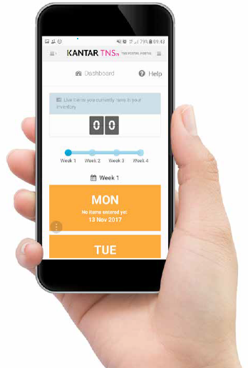
audience research data for mail
Panel of 1000 UK households
Weighted to reflect UK population
Operated by global data research organisation - Kantar
Diary based survey app
Recording all mail interactions across a 28 day period
Capturing sector and individual brand data
184,000 mail items by end of March 2021
100+ subscribers
Quarterly data releases

Slide 3
Jicmail board
Representation across the mail industry
JICMAIL is an independent, not-for-profit data and research organisation
Owned jointly by both buy-side and sell-side industry – the sell side being Royal Mail and Whistl and the buy side being the IPA and ISBA who represent the advertisers who buy mail
Sell side
Buy side

Slide 4
interaction data
JICMAIL provides a complete overview of how people receive and interact with mail and crucially what they do with it next:
INTERACTIONS RECORDED
KEY MEDIA METRICS
Opened it
Read / looked at / glanced at it
Put it on display e.g. fridge / noticeboard
Passed it on / left out for the person it’s for
Put it aside to look at later
Threw it away / recycled
Took it out of the house e.g. to work
Used / did something with the information
Put it in the usual place
REACH
how many people in the household saw it
FREQUENCY
how many times people in the household returned to it
LIFESPAN
how long mail stayed in the home

Slide 5
commercial data
JICMAIL captures what commercial actions consumers take, by mail type, by sector and by individual brand
COMMERCIAL ACTIONS RECORDED
Bought something / made a payment
Used a voucher / discount
Planned a large purchase
Discussed with someone
Visited sender’s shop / office
Visited sender’s website
Went online for more information
Looked up account details
Used a tablet / smartphone
Called the sender
Posted a reply
33%
29%
14%
Advertising
mail
Partially
addressed
Door
dropS
PERCENTAGE OF PEOPLE WHO TOOK AT LEAST ONE COMMERCIAL ACTION AFTER RECEIVING THESE TYPES OF MAIL
Source: JICMAIL, Acquisition Mail, 2020

Slide 6
Mail metrics available within jicmail
Reach and frequency data allows mail to be planned in the same way as all other media channels
LIFESPAN
reach
frequency
(How long mail stayed in the home)
(How many people in the household saw it)
(How many times people in the household returned to it)
8.2
DAYS
1.14
4.5
Advertising mail
8.3
DAYS
1.13
4.3
Partially addressed
6.4
DAYS
1.06
3.1
Door dropS
Source: JICMAIL, Acquisition Mail, 2020

Slide 7
Mail’s performance
Giving new data on how mail really performs
50,000
56,719
Reaches 6,719 more people than expected
Sent (expected REACH)
ACTUAL REACH
1%
= 500
9.77%
= 4,885
4,385 more people respond then most brands capture
Expected response %
ACTUAL Response %
50,000
212,287
Mail buys higher impacts than are measured
Expected impacts
ACTUAL impacts
0.55
0.11
Bringing the actual cost per impact down significantly
Expected £ per impact
ACTUAL £ per impact
Source: JICMAIL ROI Calculator

Slide 8
Jicmail enables users to…
1.
2.
3.
4.
5.
6.
Understand what happens to mail in the homes of customers and prospects.
Benchmark campaign performance against competitors.
Plan and evaluate mail within multi-channel data ecosystems with tools that help users extract the most value.
See how mail is driving commercial impact such as online visits or brand discussions with even greater efficiency.
Test the latest shifts in media behaviour to improve results generated from the mail channel.
Measure mail in the same way as other channels.

Slide 9
Additional benefits
Use JICMAIL to pitch, plan and measure mail
JICMAIL is integrated into existing tools
Test and measure with JICMAIL
JICMAIL is integrated into existing tools
JICMAIL is integrated into existing tools
JICMAIL is integrated into existing tools
Access to JICMAIL data is available at no cost including full training and support.
Users receive access to an intuitive data tool and are encouraged to take certification to achieve expert level knowledge.
JICMAIL is designed to be integrated with other data
sources and access is available through standard software systems for IPA TouchPoints and TGI + JICMAIL Fusion. We also provide support for other bespoke data integrations.
JICMAIL has a testing and measurement approach that seeks to help you integrate JICMAIL into your own performance and evaluation systems including a 12 point checklist for best practice Econometrics with mail.

Slide 10
THANK YOU
For access to JICMAIL data and support with information and training, please visit jicmail.org.uk or contact admin@jicmail.org.uk

