Slide 1
ROYAL MAIL DELIVERING A CLEANER FUTURE
July 2021

Slide 2
Across the Group, Royal Mail aims to decarbonise its operations through the use of alternative fuel vehicles and renewable energy solutions, whilst striving for continued efficiencies. It continues to implement measures to reduce water usage and waste generated from its operations.

Slide 3
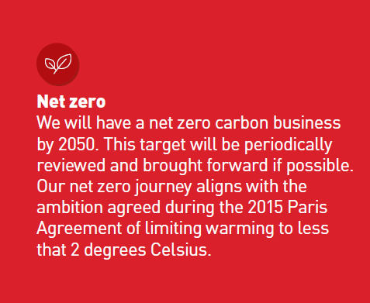
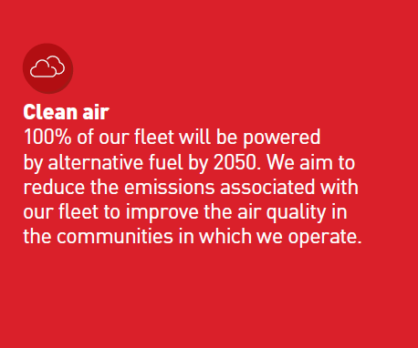
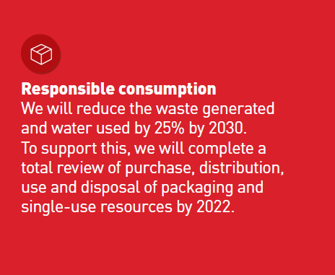
Delivering a cleaner future
3 key areas
Environmental considerations are a fundamental part of the way Royal Mail operates in the UK. With its feet-on-the-street network of over 85,000 postmen and women in the UK, it plays a key role in reducing emissions in the communities in which it works. Its environmental strategy focuses on three key areas which are outlined below:

Slide 4
Progress highlights
Royal Mail is independently rated as a leading responsible business by the most prestigious international benchmarks for sustainability. Progress highlights include:
Feet On The Street
Reducing Emissions
Diverting Landfill
Electric Vehicles
With the UK's largest "Feet on the Street" network of over 85,000 postmen and women, Royal Mail already has the lowest reported CO₂e emissions per parcel amongst major UK delivery companies.
It achieved its 2020-21 target of reducing absolute carbon emissions by 20% 4 years early
It has diverted 99% of waste from landfill (against a 95% target).
The Company is rolling out around 3,000 additional electric vehicles targeting delivery offices in areas focused on ultra-low emission zones and green cities.

Slide 5
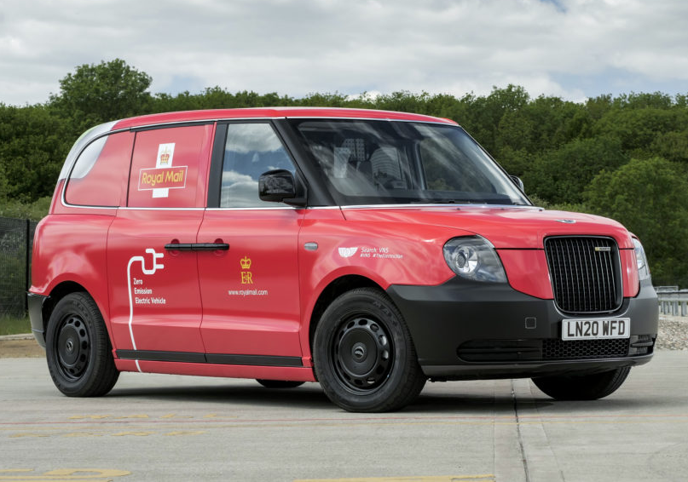
Royal mail
Advertising Association, Case Study, 2020
Royal Mail occupies a unique position within UK advertising. It is a media channel in its own right through direct mail and door drop, whilst also delivering mail from UK businesses to nearly 31 million UK households every week. Royal Mail’s commitment to the UK advertising industry is reflected in its far-reaching environmental programmes.
As a media owner, Royal Mail is committed to supporting innovation and continuous progress in products and materials used to achieve sustainable production of mail. It is encouraging best practice in materials that deliver these advances such as biodegradable inks and starch-based polymers.
Royal Mail is also committed to reducing the emissions associated with its business operations, working with suppliers and partners to reduce emissions across the value chain. Having met its 2020-21 carbon reduction target with a 31% reduction from 2004-05 levels, Royal Mail’s new environmental strategy, Delivering a Cleaner Future, will focus action in three key areas; becoming a net zero business, having a fleet 100% powered by alternative fuel, and ensuring responsible consumption.
The company has already made good progress with the introduction of electric and other alternative fuelled vehicles to its fleet, with over 300 already operational across the UK. The most recent example is a prototype electric van based on a London Taxi from the London Electric Vehicle Company. Royal Mail is committed to making changes that reduce its environmental impact, whilst ensuring it continues to innovate to meet customer expectations.
Advertising Association
Royal Mail Case Study
October 2020
Source: https://adassoc.org.uk/our-work/case-study-royal-mail/

Slide 6
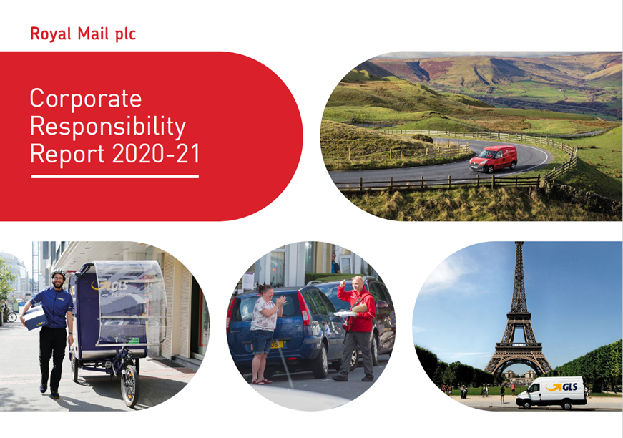
Corporate responsibility report
Royal Mail sets out its commitment and approach to responsibly managing its impact on the world in its Corporate Responsibility Report. This includes its relationships with its people, customers, communities and environment.
The Royal Mail Corporate Responsibility Report 2020/21 can be accessed here

Slide 7
THANK YOU
www.marketreach.co.uk

