Slide 1
6 OCCASIONS WHEN TO USE CUSTOMER MAIL TO DELIVER A POWERFUL CX

Slide 2
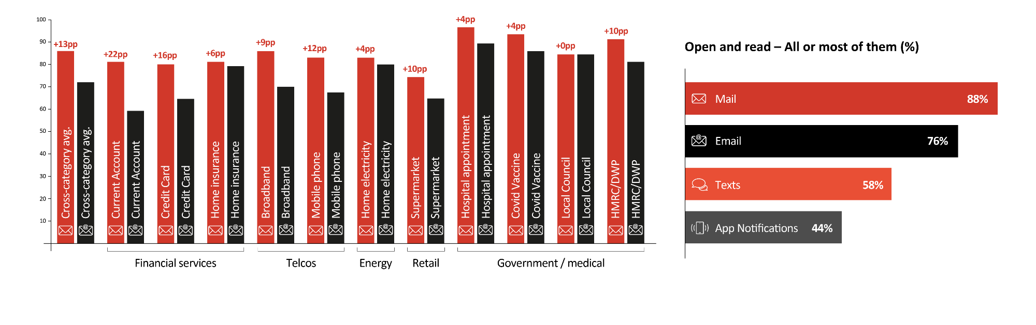
1. when the communication needs to be read thoroughly
Across all sectors, people are more likely to read mail than digital communications.
Read all or some of it in detail - About a recent mail or email communication
from category (%)
Source: Trinity McQueen 2021

Slide 3
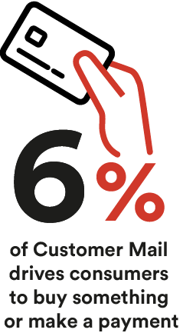
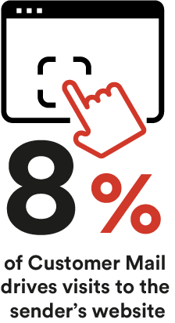
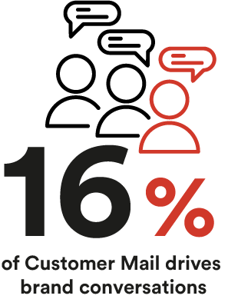
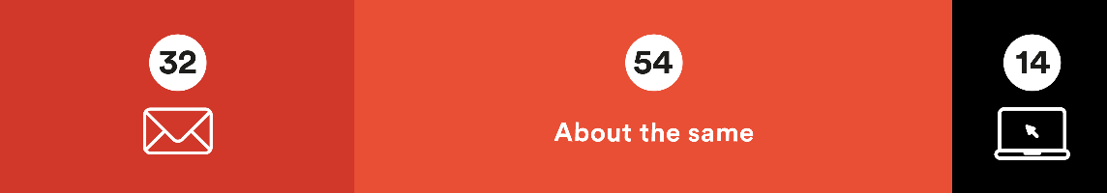
2. when the recipient needs to take action
Mail is more likely to result in an action than digital communications.
…particularly when there are multiple steps, a range of options, or for infrequent actions.
Applies more to mail or digital (%)
It’s likely to be something
I need to take action on
Source: Trinity McQueen 2021 & JICMAIL

Slide 4
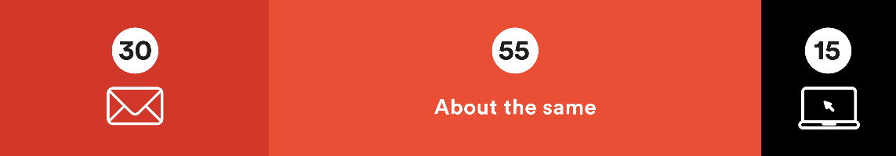
3. when the information is important
Twice as many people assume that information imparted through physical mail is important, compared to digital.
Applies more to mail or digital (%)
I would pay careful
attention to this
Source: Trinity McQueen 2021

Slide 5
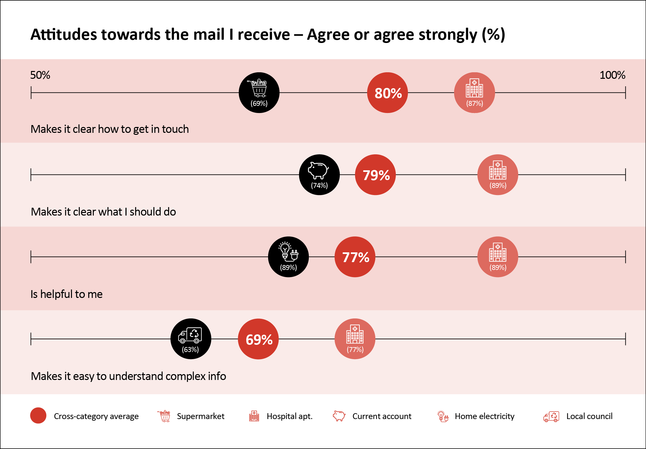
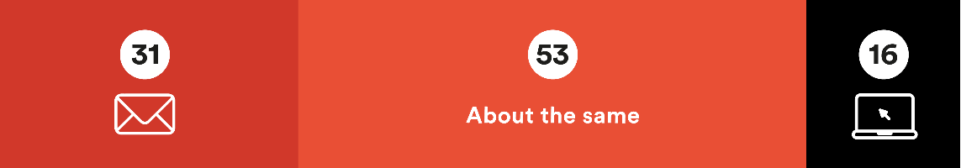
4. when the information is complex
People are twice as likely to say that they understand complex information when it is presented to them in physical mail (31%) compared to digital formats (16%).
Applies more to mail or digital (%)
A good way to help me understand complex information
Source: Trinity McQueen 2021

Slide 6
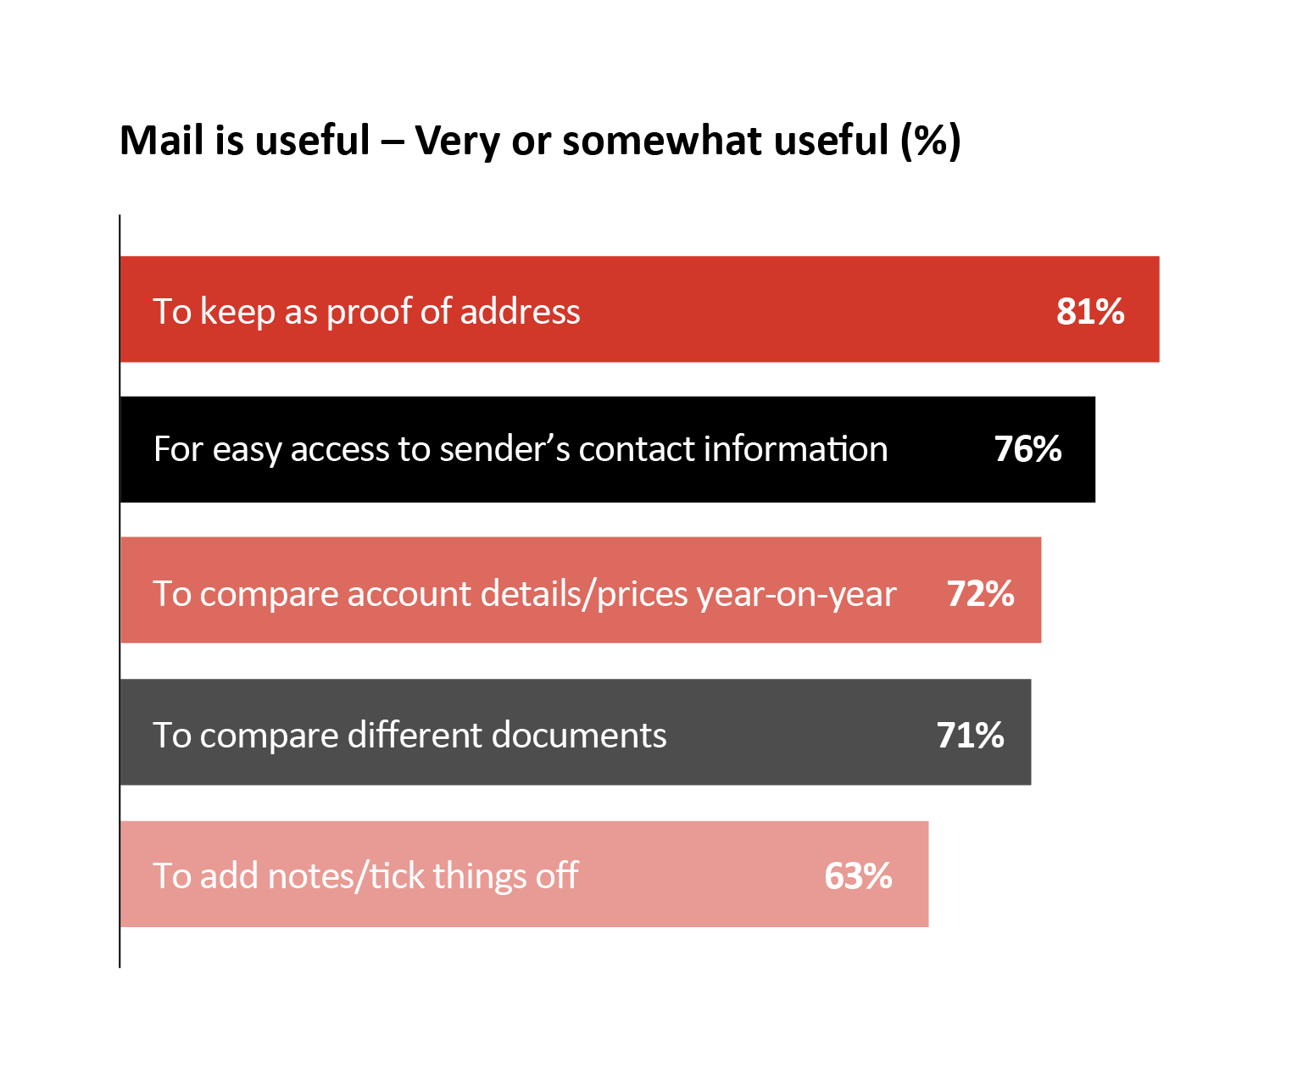
5. when the information needs to be kept
Consumers across all age groups appreciate physical mail for the ease of reference, the ability to organise and to make notes or comments. 54% say physical copies help them feel more organised.
Source: Trinity McQueen 2021

Slide 7

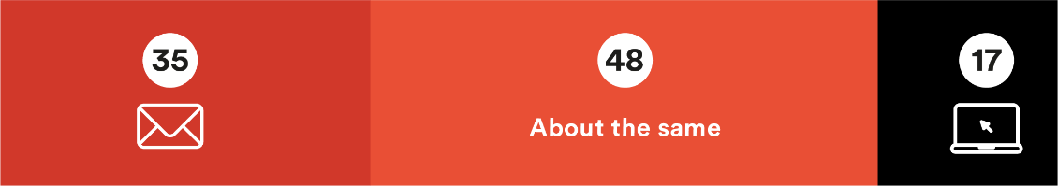

6. when there are privacy or security concerns
More than twice as many people feel that physical mail is private and secure. More people associate scams with digital channels than physical ones, by a 4-to-1 margin.
Applies more to mail or digital (%)
Feels private and secure
Same
I would think it might be a scam
Same
Source: Trinity McQueen 2021

Slide 8

Download the full report today
To download the full report, from Marketreach written in collaboration with Accenture, please follow this link:
Download the report

Slide 9

THANK YOU
www.marketreach.co.uk

