Slide 1

CATALOGUES:
CONNECTING WITH CONSUMERS.
CONVERTING SALES.
A Marketreach and Retail Week partnership

Slide 2

THE RETAIL INDUSTRY HAS EXPERIENCED AN ERA OF EXTRORDINARY challenges
Retail fragmentation has been happening for many years – retailers dealing with challenges on multiple fronts:
The accelerated growth of e-commerce
Global shopping
Consumers moving away from classic department stores and towards fast fashion
Then came the pandemic and unprecedented upheaval

Slide 3

HOW CAN CATALOGUES HELP RETAILERS
STEP UP TO THE CHALLENGE?
HOW CATALOGUES CAN HELP RETAILERS WIN IN 2023
1: CATALOGUES DELIVER RETURN ON INVESTMENT
2: OMNICHANNEL STILL BEST AND CATALOGUES PLAY CRUCIAL ROLE
3: CATALOGUE PRODUCTION CAN BE MORE SUSTAINABLE THAN YOU THINK
4: INNOVATION CREATES POWERFUL
EXPERIENCES AND RESULTS

Slide 4


1: CATALOGUES DELIVER
RETURN ON INVESTMENT
1: CATALOGUES DELIVER
RETURN ON INVESTMENT

Slide 5



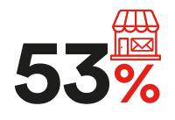



CATALOGUES WORK.
THEY CONVERT BROWSERS INTO BUYERS
26%
Looked at the
sender’s website
14%
Spoke to family
or friends about it
of consumers said catalogues give them ideas of things to buy
of people acted after receiving a catalogue – e.g. went online, visited a store
10%
Searched online
9%
Visited a
Physical store
Source: Illuminas Catalogue Research 2022: Base all: 3000

Slide 6

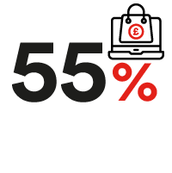


CATALOGUES CONTINUE TO DRIVE ACTION LONGER-TERM
Consumers did the following after seeing a catalogue in the last year:
visited the sender’s website
bought something they saw in the catalogue
showed or talked about something from the catalogue with a friend or family member
visited the sender’s store
The return from catalogues is about much more than the short-term impact
Source: Illuminas Catalogue Research 2022: Base all: 3000

Slide 7

2: OMNICHANNEL IS BEST –
AND CATALOGUES PLAY A CRUCIAL ROLE
2: OMNICHANNEL IS BEST –
AND CATALOGUES PLAY A CRUCIAL ROLE

Slide 8
Catalogues can optimise the impact of digital
Catalogues have evolved alongside changes in consumer behaviour
leading to a ‘streamlined’ format
Easier to navigate, fewer pages, smaller format designed to drive people online
and so work with not against digital, with powerful results since last measured in 2017:
+15ppt
+ 4ppt
people looking at or visiting sender’s website or social platform
increase in people saying catalogues gave them ideas for things to buy
ppt: percentage points
Source: Illuminas Catalogue Research 2022: Base all: 3000

Slide 9

CATALOGUES deliver experiences
THAT DIGITAL DOES NOT
Catalogues transform the consumer experience. They’re enjoyable, enabling consumers to get away from it all
I enjoy sitting down and looking through them in my own time
I find browsing for items in catalogues more enjoyable than on a screen
Reading a catalogue is a way
to escape from the busy world for a while
60% of respondents
53% of respondents
48% of respondents
  Catalogues are a 1-2-1 channel where brands can tell stories and share rich
  content that consumers actively enjoy - this generates sales directly AND builds
  ongoing relationships, leading to loyalty
Source: Illuminas Catalogue Research 2022: Base all: 3000

Slide 10
and cut through THE DIGITAL overload
Consumers feel a digital marketing deluge, but welcome receiving catalogues
60%
68%
45%
45%
“I receive far too many marketing emails from companies”
“I’m more likely to notice a catalogue in the post than an email”
“There are some catalogues I look forward to receiving”
“Receiving a catalogue from a company I use makes me feel like a valued customer”
Catalogues can get messages through that may never be seen on digital channels
10
Source: Illuminas Catalogue Research 2022: Base all: 3000

Slide 11

3: CATALOGUE PRODUCTION CAN BE MORE SUSTAINABLE THAN YOU THINK

Slide 12


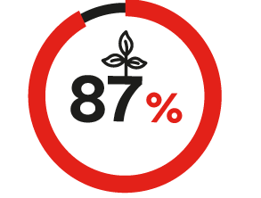
CONSUMERS VALUE SUSTAINABILITY
  Customers increasingly making purchase decisions based on the environmental credentials of a business
4 out of 5 people choose a brand with a positive approach to environmental sustainability
90% of people agree that it is vital that society becomes more energy-conscious
87% of customers want brands to act now to encourage future sustainability
All media leaves a carbon footprint but brands can't just turn off marketing –
need to balance environmental impact with commercial gain and customer benefits
Source: Marketreach: Using mail more sustainably: A step by step guide

Slide 13

TANGIBLE STEPS TO TAKE TO INCREASE SUSTAINABILITY of catalogues
Choose sustainability-focused suppliers, BCorp printers and communicate their environmental credentials to customers
Check database is accurate and up to date
    Catalogues are data-driven and targeted so less wasteful
Reduce size and pagination (where appropriate) and drive online
Choose soy-based or vegetable/vegan inks
Paper wrap, for A4 or C5 large catalogues, is 100% recyclable and less harmful to our planet than plastic polywrap
Nearly all paper can be recycled and turned into new paper for someone else to use
There are many more ways to improve catalogue sustainability. Find out more here
Source: Marketreach: Using mail more sustainably: A step by step guide

Slide 14

4. INNOVATION CREATES
POWERFUL EXPERIENCES AND RESULTS
4. INNOVATION CREATES
POWERFUL EXPERIENCES AND RESULTS

Slide 15

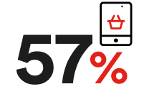
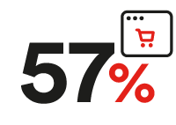
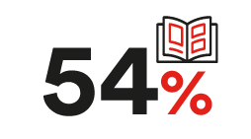
AND HELP CONNECT WITH AUDIENCES
IN NEW WAYS
Interest is high when consumers are asked about what new types of catalogues they would be interested in:
A customised catalogue with content you’ve told us you’re interested in
The ability to scan something in a catalogue to see how it might look on them/in their home
A printed catalogue with an easy way to scan and visit the retailer’s website
Personalised catalogues based on their previous purchases
Marketreach works with retailers to advise on the best digital innovation to effectively meet business and consumer needs
Source: Illuminas Catalogue Research 2022: Base all: 3000

Slide 16

Summarising the benefits for retailers
HOW CATALOGUES CAN HELP RETAILERS WIN IN 2023
1: CATALOGUES DELIVER RETURN ON INVESTMENT
2: OMNICHANNEL STILL BEST AND CATALOGUES PLAY CRUCIAL ROLE
3: CATALOGUE PRODUCTION CAN BE MORE SUSTAINABLE THAN YOU THINK
4: INNOVATION CREATES POWERFUL
EXPERIENCES AND RESULTS

Slide 17

How Marketreach can help
Start planning your catalogue activity now to optimise seasonal peaks such as summer, Black Friday and Christmas
Harness the expertise of our team:
  To explore what competitor brands are doing in this space
  Guide and optimise your creative approach with eye-tracking software
  Discuss test and learn
  Access best practice case studies that show how retailers are optimising the powerful combination of digital and physical experiences
  Learn more about sustainable mail
Download our report and get in touch to find out how Marketreach can help you use catalogues to achieve your goals

