Slide 1
WHY MAIL IS A TRUSTED MEDIUM FOR CONSUMERS
Trust in brands has never been more important and mail commands high levels of trust

Slide 2
people are feeling less confident
And when they are less confident they seek greater assurance from brands
Brexit, COVID, the war in Ukraine, the cost-of living crisis… since 2016 it feels like it’s been “one thing after another”
This lack of confidence and avoidance of risk drives consumes towards brands they see as being reliable
The chart shows the % change in these considerations from June 2022 to June 2023
These are statistically significant increases
Trust is now a top consideration in consumer brand choice +4% year on year
Top considerations when buying a brand, 2023 vs 2022
+4
+2
+4
+2
Source: Special Report – Brand Trust, Edelman, 2023

Slide 3
Mail is a highly trusted channel
71%
I completely trust the mail I receive
Brand equity is largely about trust.
Good relationships are built on trust.
And more and more, the trust factor is what motivates consumers to do business with brands and to stay loyal to them.
Source: Marketreach, Trinity McQueen, Customer Mail, 2021

Slide 4
Consumers recognise mail’s superpowers
38%
49%
40%
Consumers are more than 2.5x as likely to agree than disagree that they trust communications sent by mail more than email
(15% trust email)
Consumers are more than 2x as likely to agree than disagree that important information should be sent by mail rather than email
(19% for email)
Consumers are 2x as likely to agree than disagree that they pay more attention to something sent in the mail than something sent using email
(21% for email)
Source: TGI Quick Connections 2022

Slide 5
Consumers prefer having the option to choose paper
Attitudes towards choice of comms / digital channels
Agree (Disagree)
83%
28%
67%
(3%)
(47%)
(3%)
People should have the choice of whether they get communications by mail or email
It’s right for companies to ask customers to pay more to get mail communications
Too many companies expect me to download their app
Source: Marketreach, Trinity McQueen, Customer Mail, 2021

Slide 6
mail IS MORE LIKELY TO BE READ IN FULL
Open all or most of them
Source: Marketreach, Trinity McQueen, Customer Mail, 2021

Slide 7
Physical mail is private and secure
Customers prefer physical documents for content that is sensitive or of a personal nature. Twice as many people feel that physical mail is private and secure compared to digital. Four times as any people associate scams with digital compared to physical mail.
Applies more to mail or digital
Source: Marketreach, Trinity McQueen, Customer Mail, 2021

Slide 8
Mail, A powerful role in helping people manage, organise and be in control
Mail is useful… very or somewhat useful (%)
These findings apply equally across all age groups
Source: Marketreach, Trinity McQueen, Customer Mail, 2021

Slide 9
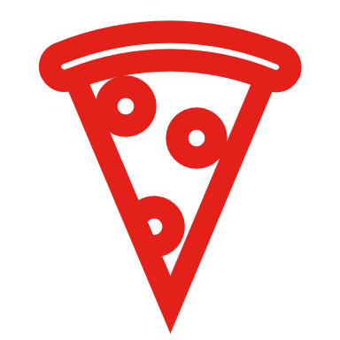
MAIL builds positive brand perceptions
Q. Having received this mail item, how do you feel about the company that sent it?
58%
50%
Dear Coffee Lover
Source: Marketreach, Blue Yonder, Attention Research, 2023

Slide 10
PLEASE USE THESE SLIDES FREELY
www.marketreach.co.uk

