Slide 1


DISCOVER THE CIRCULAR ADVANTAGE OF MAIL

Slide 2
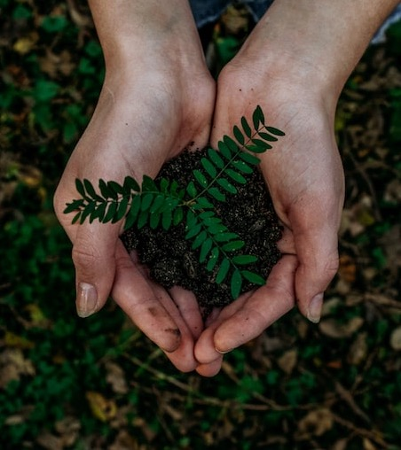
Why mail and circularity?
Just like every other sector and industry, in the face of an environmental and climate emergency, mail needs to continue to transition to be part of a low-carbon, nature positive and truly sustainable economy.
Business as usual is no longer feasible on a finite and warming planet with rising energy and commodity costs. Together, we must all take a more circular approach – reducing waste, pollution and greenhouse gas emissions.
As the leading champion of mail, Marketreach & Royal Mail have a significant responsibility to demonstrate leadership and ambition in this area - to work with the industry, accelerate change and ensure that mail is contributing to a more circular and sustainable economy.

Slide 3
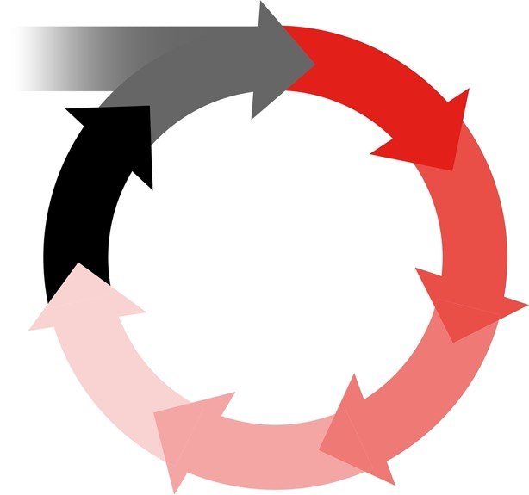
WHAT IS A CIRCULAR ECONOMY?
DESIGN
In our current economy we take materials from the Earth, make products from them, and eventually throw them away as waste – the process is linear.
In a circular economy, by contrast, we stop waste being produced in the first place.
RAW MATERIALS
PRODUCTION
RECYCLING
RETAIL
CIRCULAR
ECONOMY
TAKE
MAKE
USE
DISPOSE
WASTE
COLLECTION
COMSUMPTION
LINEAR ECONOMY
REUSE & REPAIR

Slide 4

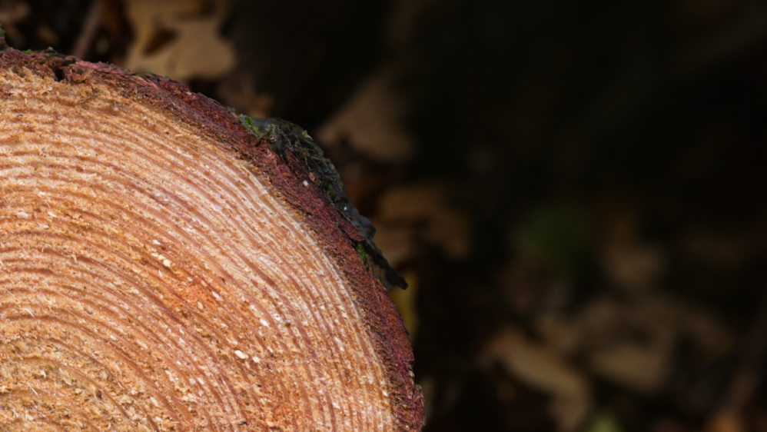




REUSE / RECYCLE
Reuse can be simply fixing things, remanufacturing and recycling
products to avoid the journey to landfill.
REGENERATE
Think of this as using natural resources that regenerate and help to recapture energy – like trees for paper.
CIRCULARITY CONSISTS OF
4 x R'S ACROSS THE SUPPLY CHAIN
REDUCE
A reduction in materials which therefore minimises impact and reductions in pollution and emissions.
REINVENT
Human ingenuity to design out waste.

Slide 5
How does mail contribute to a circular economy?
REGENERATION
Paper comes from a natural, regenerative crop - trees. Using raw materials sourced from a thriving, sustainably-certified forest supports tree planting and biodiversity, protects long-standing forests and helps draw-down more carbon dioxide from the atmosphere.
FSC
REINVENTION
Low-impact modern paper mills run on 100% renewable energy, use total chlorine-free processes and 93% of water involved is recycled - and some can even generate
more renewable energy than they use.
Two Sides Paper Advance CPI
REDUCTION
Distribution fleets are rapidly decarbonising - Royal Mail is rapidly switching to renewable energy and using more electric vehicles, electrifying operations, finding low-carbon solutions and ensuring van loads are more efficient - not forgetting posties delivery on foot. Royal Mail
RECYCLING AND REUSE
Paper is readily recycled and can be reused again and again to extend the life of mail. Over 70% of the fibres used to make paper in the UK is recycled and can be reused many times over - on average paper is reused 3.8 times, and sometimes up to 7 times. CPI Two Sides
Low-carbon, energy-efficient printing processes can use biodegradable and water-based inks, find alternatives to plastics, and run on clean energy. Inside Packaging

Slide 6
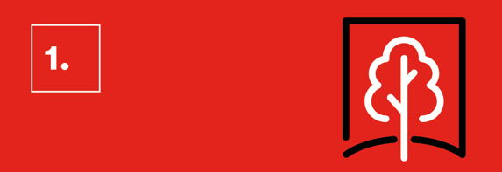
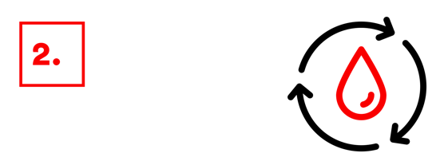
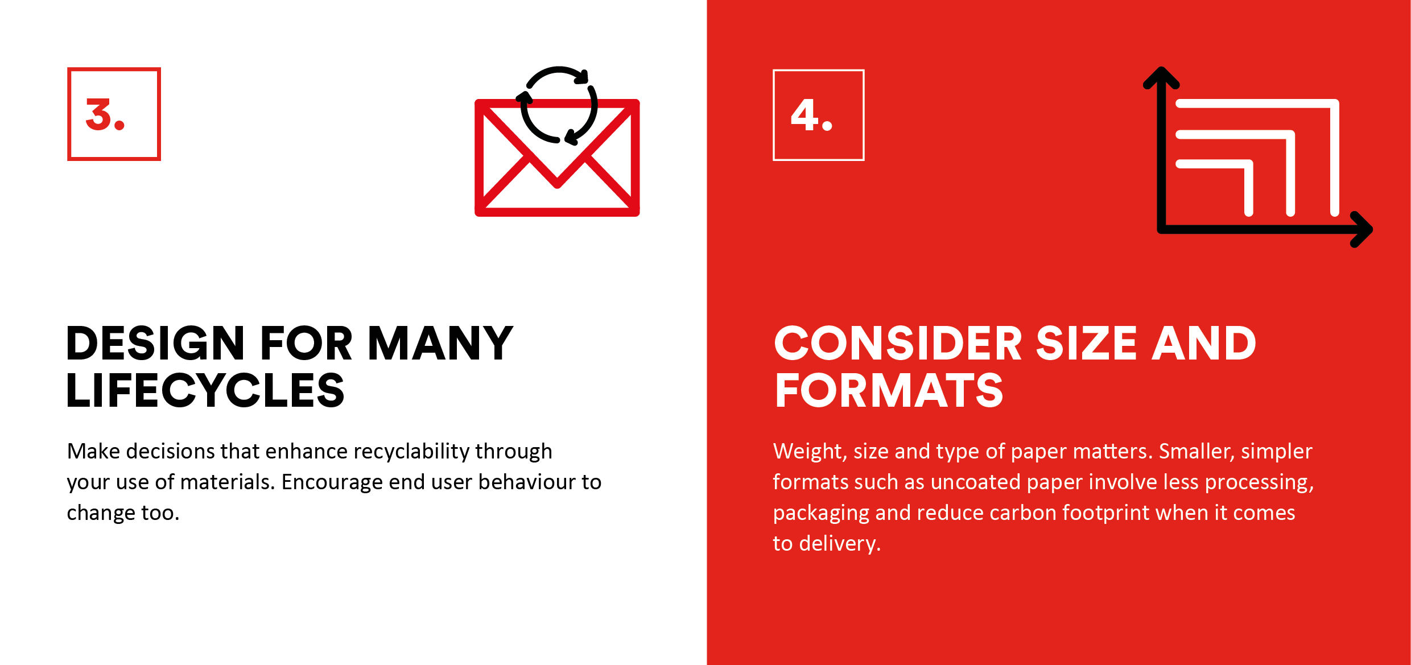

ENSURE PAPER IS SOURCED FROM CERTIFIED FORESTS
THINK ABOUT INK
Are the inks you’re using biodegradable? Biodegradable inks use natural vegetable oils, such as soy, sunseed or rapeseed oil. Is the amount of ink coverage appropriate? Would less dense inks be suitable, saving more energy during printing?
Check the paper you’re using is certified. A well-managed forest absorbs more carbon dioxide (CO₂) than a mature forest. In fact, forests represent the only proven “carbon capture and storage” system available at present.
TIPS TO MAKING YOUR MAIL MORE SUSTAINABLE
Speak to your printers to ask about how you can apply these tips to your next mail pack.
DESIGN FOR MANY LIFECYCLES
CONSIDER SIZE AND FORMATS
Make decision that enhance recyclability through your use of materials. Encourage end user behaviour to change too.
Weight, size and type of paper matters. Smaller, simpler formats such as uncoated paper involve less processing, packaging and reduce carbon footprint when it comes to delivery

Slide 7
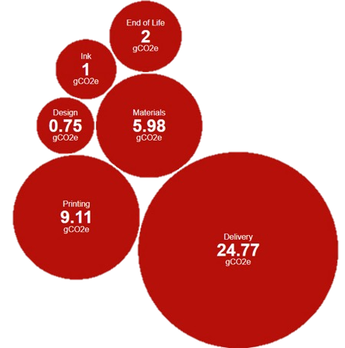
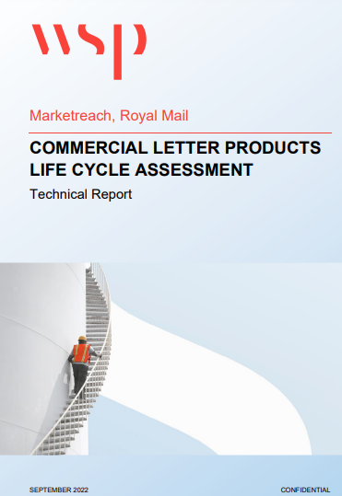
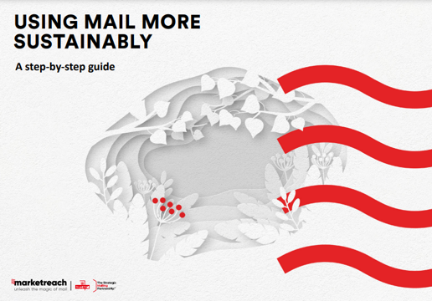
CHECK OUT OUR tools
Marketreach can provide the tools and insight to help you make more informed choices to create more sustainable mail campaigns that reduce the impact on the environment.
Check out our Life Cycle Assessment (LCA) report and LCA tool to understand the carbon footprint of different mail formats.
And our Using Mail More Sustainably Guide, for guidance and tips on the various opportunities to make your mail campaigns more sustainable.
Please visit our website to access these resources.

Slide 8
1.
2.
CHAMPION CIRCULARITY
ENHANCE
REGULATION
Together
we can
3.
4.
SHARE BEST PRACTICE
RADICALLY SHIFT SUPPLY CHAINS

Slide 9
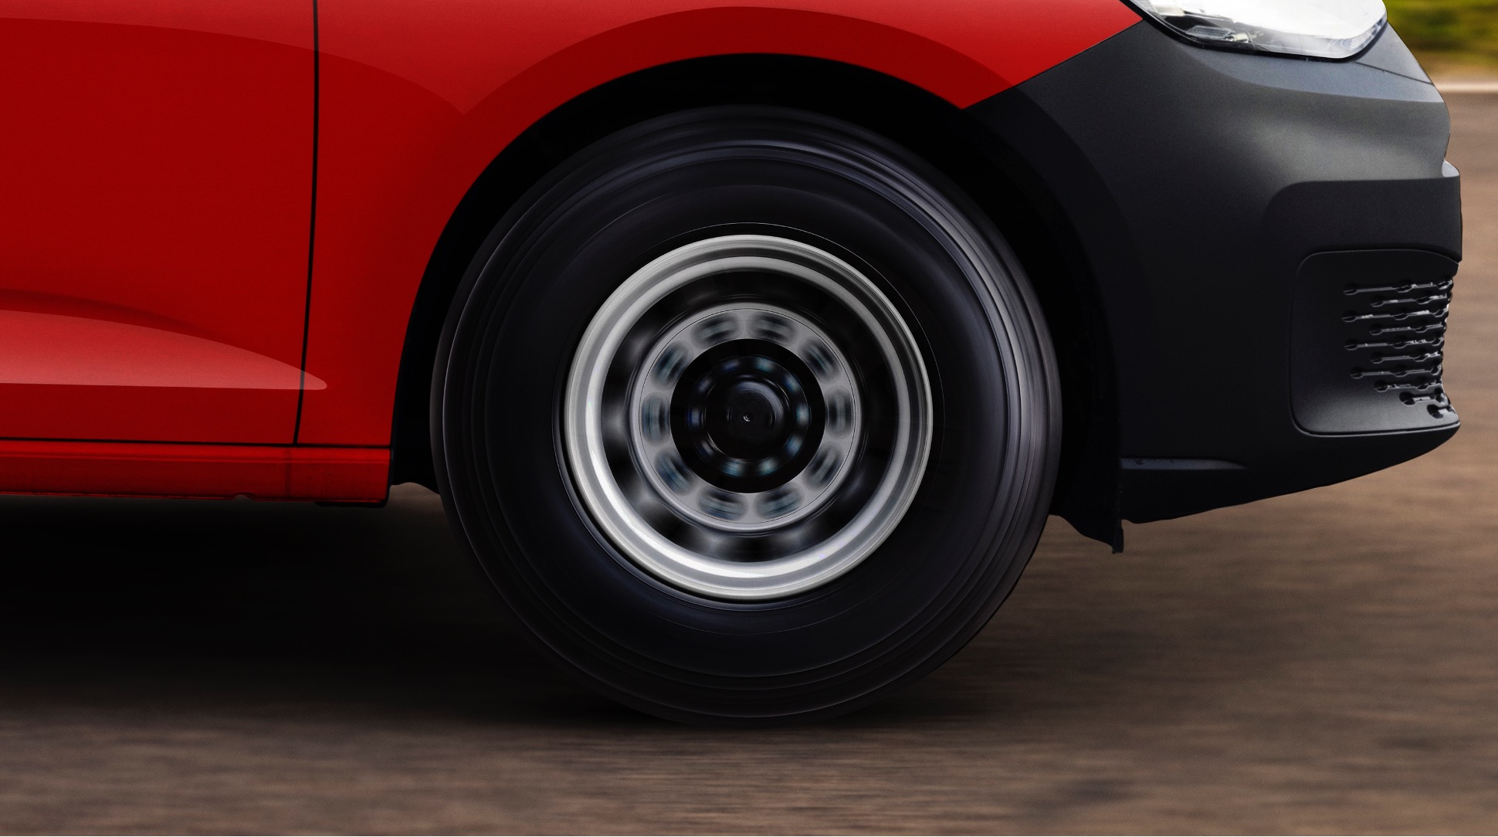
CIRCULARITY IS A JOURNEY
AND THIS IS JUST THE BEGINNING

Slide 10
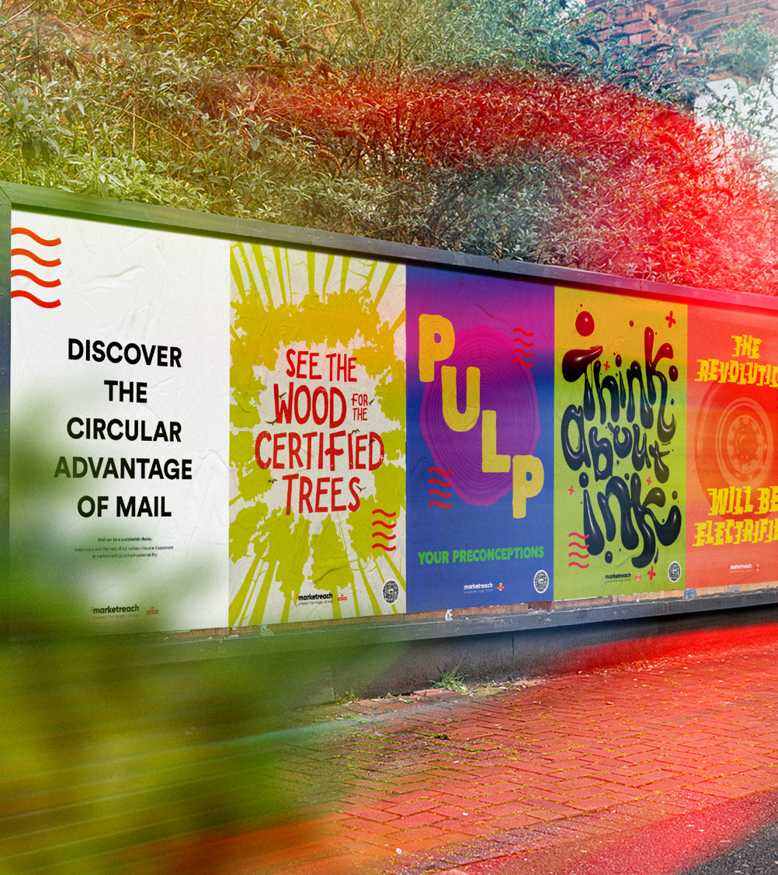

THANK YOU
For more information and updates on sustainability visit marketreach.co.uk/mail-sustainability

